Slide 1


Lift up a child's voice
A child's life.™
THE NATIONAL CASA PRE-SERVICE VOLUNTEER TRAINING
FLEX Version , May 2018

Slide 2
Pre-Service Training: Day 1
Putting a Face with the Name
Your name.
One reason for volunteering.
Choose ONE to answer:
  What’s your hidden talent or fun fact?
  What was your first concert and what do you wish it had been?
  If you could be in any movie or TV show, what would it be and why?
  Which person from history would you most like to meet?

Slide 3

Pre-Service Training: Day 1
Our Agreements
Stay engaged
Listen to understand
Speak your truth responsibly
Be willing to do things differently and experience discomfort
Expect and accept non-closure
Respect confidentiality

Slide 4
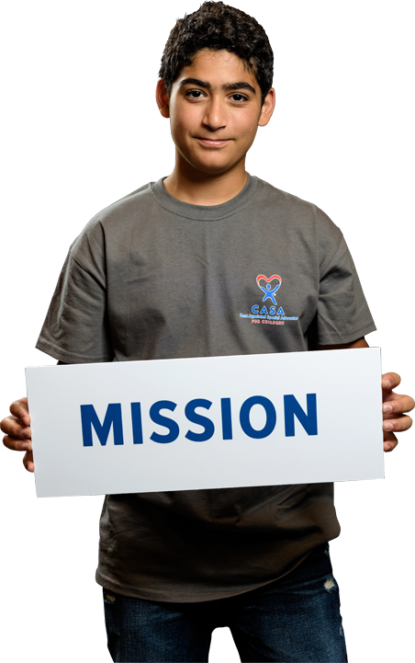
Pre-Service Training: Day 1
CASA of Marion County Mission & Purpose
We provide every child in need with a trained volunteer advocate to ensure they are safe, have a permanent home and the opportunity to thrive.
To achieve the mission we recruit volunteers from our community, train them so they have the skills and knowledge necessary to advocate for an abused child, and professionally support them so they are able to do this difficult work successfully.
There is no other agency or program providing volunteer advocacy to abused and neglected children who are living in foster care.​

Slide 5
Pre-Service Training: Day 1
Recap of Online
Bleux Case File
Four Core Functions of a CASA/GAL Volunteer
John’s Story
History of Child Welfare Laws
Best Interest Principle
Minimum Sufficient Level of Care (MSL)
Introduction to Court Report

Slide 6


Pre-Service Training: Day 1
Competencies for Volunteer Advocates
1C
Sound Judgment
Foundations of Knowledge
Communication
CASA Role
Cultural Competence
Initiative
Self-Care
Notes:
Facilitator Notes:
Understand your role as a CASA
Be able to utilize effective communication
Develop or solidify cultural competence
Exercise Sound Judgement
Must have the initiative to reach out, engage, be proactive.
Build foundations of knowledge through Initial Training and Continuing Education.
Take care of yourself- this isn’t always easy work!

Slide 7
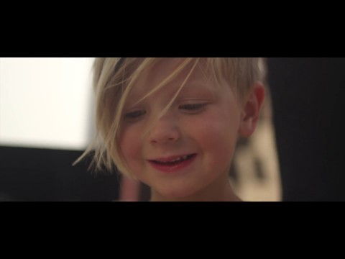
Pre-Service Training: Day 1
5 Things CASA Does for Children

Slide 8
Pre-Service Training: Day 1
Parameters of the Volunteer Role
Information Gathering
Facilitation
Advocacy
Monitoring
Notes:
Info gathering- Discovery, direct communication, meetings, assessments/evaluations, contacting providers
Facilitation- request meetings, recommendations could lead to services
Advocacy- make recommendations, communicate them through court reports, communication with caseworker, foster parents
Monitoring- see the child every 30 days, stay in touch with essential case providers, keep up on case documents.

Slide 9
Pre-Service Training: Day 1
Parameters
Mentor
Advocate
Notes:
Discuss how being a mentor and being an advocate are similar but also very different in our CASA roles.
We are a support, a friend, and a positive role model
We do not provide direct professional services (tutoring, counseling, therapy)

Slide 10

Pre-Service Training: Day 1
Activity Time: Dilemmas
While working in your assigned groups:
Read the dilemma to your group.
Figure out the crux of the dilemma.
Discuss possible consequences.
Come up with solutions.
Notes:
Facilitator Notes: Split the class into groups. Allow 5-10 minutes for the groups to discuss their assigned dilemma. Come back as a class to discuss each group’s crux, potential consequences and solutions.
The dilemma cards can be found in the Pre-Service Training Binder.

Slide 11
Pre-Service Training: Day 1
Dilemmas
Dilemma #1
As a CASA/GAL volunteer, you are on your way to your very first visit with a 9-year-old girl named Susan. Right before you leave, you call the paternal grandfather, who is caring for Susan, and find out that she just had some teeth pulled and some other dental work done. You ask the grandfather what type of milkshake Susan might like. He tells you that she prefers chocolate but also mentioned that the dentist prescribed some mild painkillers and antibiotics. He already phoned them in to the pharmacy which is right next to the local milkshake shop, but he doesn’t have a car to go get them. Since you pass the pharmacy on the way and since it is right next to a milkshake shop, he was wondering if you could swing by and pick them up. The prescriptions are already paid for. You are unsure of CASA’s policy in regards to medication handling but Susan's mouth is going to be sore from all the dental work, and this would be a great way to start out your relationship as her volunteer advocate… What do you do?
Prepare to discuss the crux of the dilemma, potential consequences and one possible solution.
Dilemma #2
You have developed a great working relationship with Michele, the birth mother in your case. The case is going well, and there is talk of returning all four of her children home. At this time, the agency’s only concern is that Michele’s budget is very tight; she will have to maintain employment in order to make ends meet. She has an unsteady employment history and has previously disclosed that she is stressed about the idea of having all four children return home at once. One day you are meeting with Michele when she leans in close and says she has a secret. She asks you to “pinky swear” that you won’t tell anyone. You really want to find out what the secret is, but you also don’t want to break Michele’s trust. She leans in to tell you that she is expecting another child and will have to leave her job to prepare for the birth of the new baby... What do you do?
Prepare to discuss the crux of the dilemma, potential consequences and one possible solution.
Notes:
Split the Zoom meeting into two groups paring each group with a coordinator. Assign a dilemma to each group to discuss and then present to the class.
Optional: This activity can be repeated on the next slide.

Slide 12
Pre-Service Training: Day 1
Dilemmas
Dilemma #3
You have been appointed to the case of an 8-year-old boy who was recently placed into a group home due to destructive behavior. The social worker advises you that he is in a three-week black-out period, during which he can neither have visitors nor participate in any outside activities. You think this is grossly unfair to the child. You’ve addressed your concerns with the group-home staff, the caseworker, and the child’s attorney. You’ve even included it in your court report, to no avail. You tell the social worker how disappointed you are that they aren’t doing their job. The conversation goes nowhere, and you are even more frustrated. You decide to go home to unwind.
While searching the Internet, you come across a Facebook page for child advocates. You think to yourself that this would be a great opportunity to voice your frustrations to other like-minded individuals, but you know you can’t provide any information that would compromise confidentiality... What do you do?
Prepare to discuss the crux of the dilemma, potential consequences and one possible solution.
Dilemma #4
You have been working with a teenage sibling group for almost a year. Yolanda, the youngest of the four siblings, is at a local youth shelter after running away from her former placement to see her sisters, who are all placed in another county. You are at the shelter for a visit and a team meeting with the shelter staff to discuss Yolanda’s case. During the meeting, Yolanda becomes so upset that she runs out of the shelter and goes to her sister’s resource home nearby. You accompany staff to the resource home in an effort to persuade Yolanda to return voluntarily to the shelter. Yolanda agrees to cooperate with the staff, but upon her return, she confides in you that she is lonely and doesn’t have anyone to talk to. She isn’t allowed to use the phone after a certain hour, and she’d like to have a cell phone to stay in contact with her sisters. She asks you to purchase one for her. What do you do?
Prepare to discuss the crux of the dilemma, potential consequences and one possible solution.

Slide 13
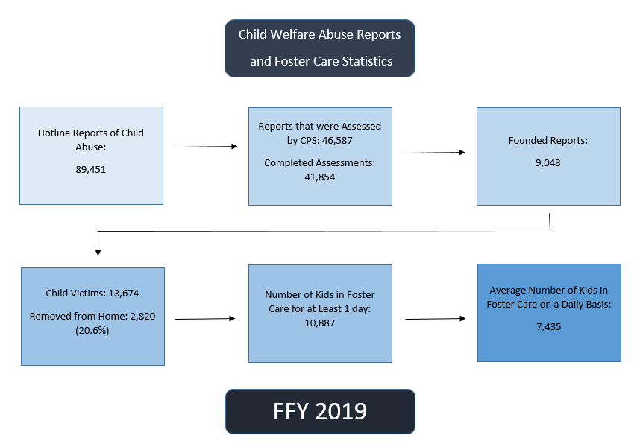
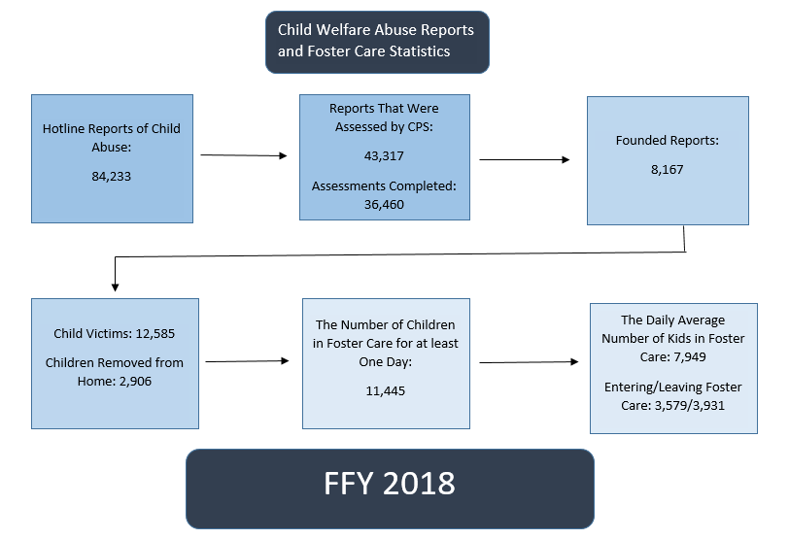
Pre-Service Training: Day 1nderstanding Abuse and Child Welfare: Understanding Abuse and Neglect
Notes:
Facilitator Notes:

Slide 14
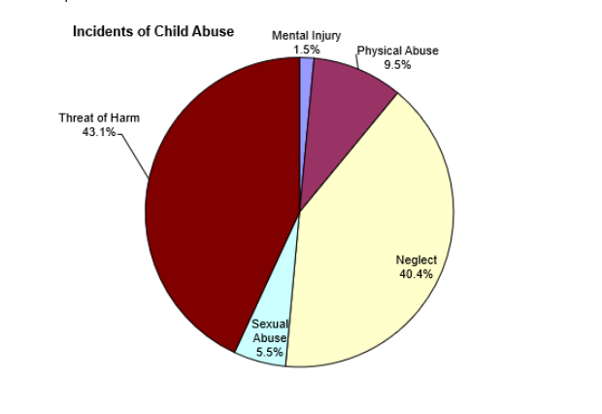
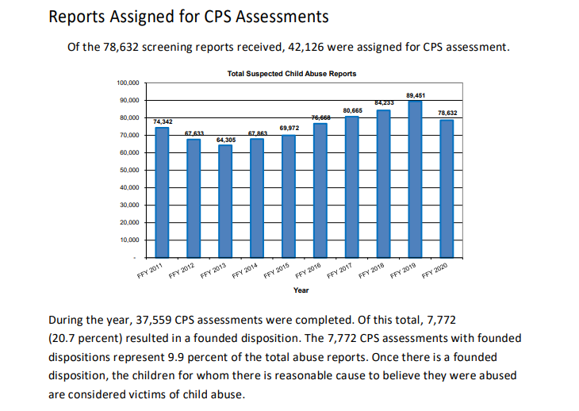
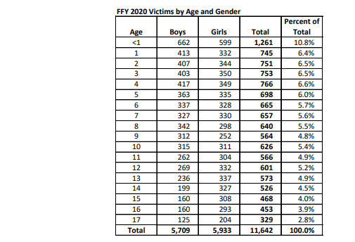

Pre-Service Training: Day 1nderstanding Abuse and ODHS Child Welfare Child Abuse and Neglect for 2020
Notes:
Facilitator Notes:

Slide 15
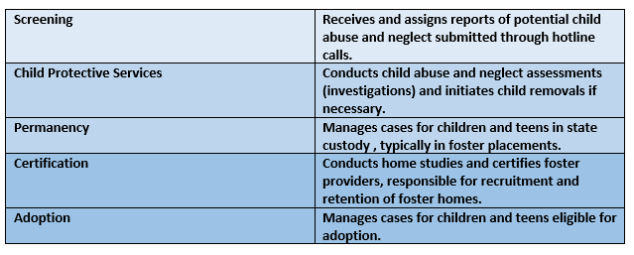
Pre-Service Training: Day 1nderstanding Abuse and Child Welfare: Understanding Abuse and Neglect
Child Welfare- DHS Caseworker Types
Notes:
Facilitator Notes:

Slide 16
Pre-Service Training: Day 1
Recognizing Child Abuse and Neglect
CASA/GAL volunteer can’t determine child abuse or neglect; the court will decide
CASA/GAL volunteers should recognize signs of abuse and neglect and advocate for a safe home for a child
Child abuse can be physical, sexual, emotional or neglect
Physical
Sexual
Emotional
Neglect
Notes:
Facilitator Notes:
Factors not related to abuse, but related to trauma or stress indicate that a child is in need of help and support

Slide 17
Pre-Service Training: Day 1
Risk Factors - Child Abuse and Neglect
Child related factors
Parent/caretaker related factors
Social situational factors
Family factors
Triggering situations
Notes:
CHILD: Baby is sickly, colicky or unwanted
Child has a physical or developmental disability
Child is the product of an abusive relationship
Lack of attachment between child and parent
PARENT: Parent has already abused a child
Pregnancy was not wanted
Parent has a background of abuse when growing up
Young, unsupported mother often with low education
Parents have unrealistic expectations of the child and lack parenting knowledge
Parent is isolated and has few supports
Parent has a mental illness or is abusing drugs or alcohol
SOCIAL: socio-economic disadvantage
parental unemployment
housing stress
lack of access to social support
lack of pre-natal care
neighborhood disadvantage
FAMILY: Overcrowding in the house
Poverty or lack of opportunity to improve the family’s resources
Family violence is present
A non biological adult living in the house
Family is experiencing multiple stresses
TRIGGERING: neighborhood violence
Job loss
Parental depression

Slide 18
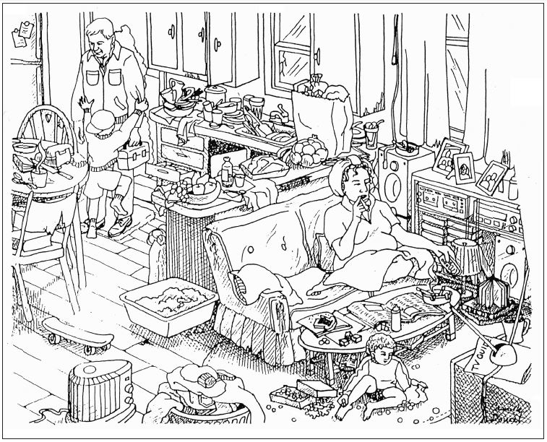
Pre-Service Training: Day 1
Cluttered Home
Notes:
Have everyone analyze the image and write down what they see. After 4-6 minutes, let trainees discuss their observations.
The Purpose: The purpose of the exercise is to engage the learner’s ability to see through a strength based and resourced based lens. In the next couple slides this will be addressed along with recognizing your own bias and values.

Slide 19
Pre-Service Training: Day 1
Family Strengths and Weaknesses
Your ability to identify strengths in families depends on which lens you use in your advocacy work:
  If you see through a deficit lens, you focus on family problems.
  If you see through a resources lens, you focus on identifying family strengths.

Slide 20

Pre-Service Training: Day 1
Family Strengths and Weaknesses
Questions to ask when using a resources lens:
  How has this family solved problems in the past?
  What court-ordered activities have family members completed?
  Does the family have extended family or non-relative kin who could be a resource?
  How are family members coping with their present circumstances?

Slide 21


Pre-Service Training Day 1 :
National CASA Guiding Principles
National CASA Vision Statement and Guiding Principles
As a general term “diversity” refers to difference or variety. In the context of CASA/GAL volunteer work, “diversity” refers to differences or variety in people’s identities or experiences: ethnicity, race, national origin, language, gender, religion, ability, sexual orientation, socioeconomic class and so on.
The term “cultural competence” refers to the ability to work effectively with people from a broad range of backgrounds, experiences and viewpoints. The United States is becoming increasingly multicultural.
According to the 2010 US Census, approximately 36.3% of the population currently belongs to a racial or ethnic minority group. The Census Bureau projects that by the year 2100, non-Hispanic whites will make up only 40% of the US population.

Slide 22

Pre-Service Training Day 1 :
Understanding Diversity
Diversity refers to the differences or variety in people’s identities or experiences: ethnicity, race, national origin, language, gender, religion, ability, sexual orientation, socio-economic class and so on
How important do you think understanding diversity and cultural
differences is in the world of child advocacy work?
Notes:
Facilitator Notes
Additional Information to be shared in class:
There are parts we can see, and parts we can’t see but know are there:
The visible parts include dress, music, food & games
The invisible parts include unwritten rules guiding patterns of speech, concepts of time and the meanings of body language
In order to keep the session engaging, it’s always a good idea to encourage the participants to interact with you and share any questions or concerns they might have.
For this topic, you can ask the participants what their perspective on culture is.

Slide 23

Pre-Service Training Day 1 :
Understanding Culture
What
To
Does
Culture
Mean
You?
Culture is a learned pattern of customs, beliefs and behaviors, socially acquired and socially transmitted through symbols and widely shared meanings
Through culture, people and groups define themselves, conform to society's shared values, and contribute to society
Notes:
Facilitator Notes
Additional Information to be shared in class:
There are parts we can see, and parts we can’t see but know are there:
The visible parts include dress, music, food & games
The invisible parts include unwritten rules guiding patterns of speech, concepts of time and the meanings of body language
In order to keep the session engaging, it’s always a good idea to encourage the participants to interact with you and share any questions or concerns they might have.
For this topic, you can ask the participants what their perspective on culture is.

Slide 24
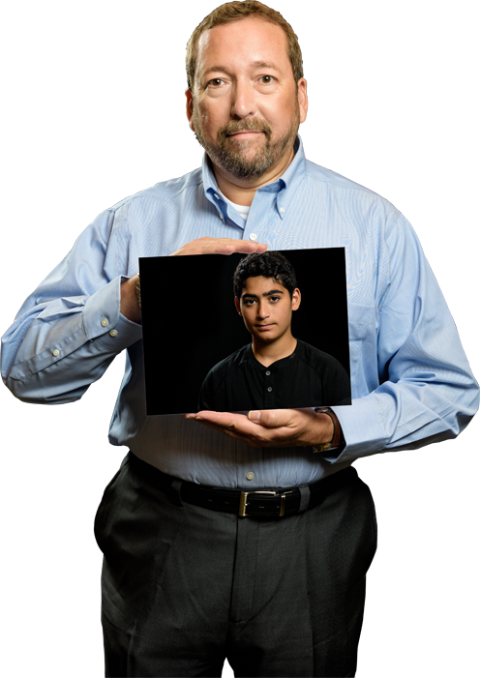
Pre-Service Training: Day 1
Advocating for LGBTQ+ Youth
A recent national survey reveals that up to 30% of youth in foster care are lesbian, gay, bisexual, transgender, queer, and questioning (LGBTQ+)
As a CASA volunteer you must show professionalism, appropriateness, and cultural competency skills in advocating for such youth.
Notes:
Reference the following handouts which can be found in the Pre-Service binder.
LGBTQ Key Terms
Safer Brighter Future (This is to long to go over in class - have participants read on their own time if they are interested or need the resource)
The Spectrum
(Charles can pull these on screen as you mention them as well

Slide 25
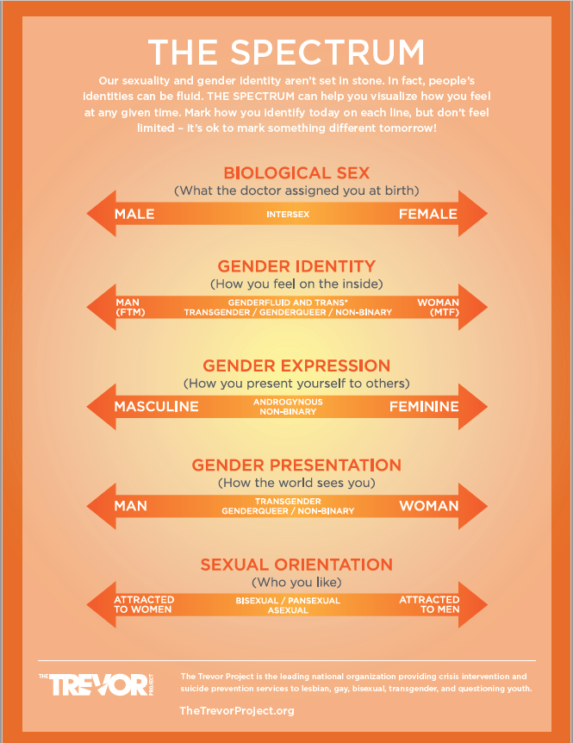
Pre-Service Training: Day 1
Advocating for LGBTQ+ Youth
LGBTQ+ youth in foster care are disproportionately overrepresented, less likely to be placed in family settings, more likely to experience multiple placements, less likely to be adopted, more likely to experience maltreatment while in an open case, and more likely to become homeless. –The Trevor Project
Check out some of the additional resources CASA has to offer on LGBTQ+ in your dropbox.
Notes:
(Charles can pull an other drop box files on screen if you wish to go over them)

Slide 26
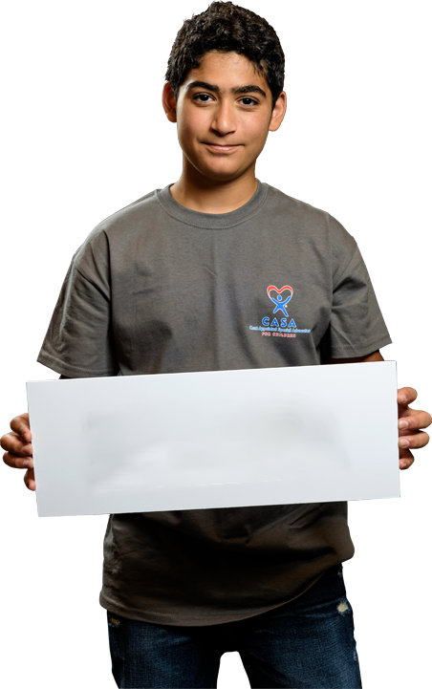
Pre-Service Training: Day 1
Recognizing Your Values
  You may be assigned to a case that you would find difficult.
  Mental illness, substance abuse, domestic violence, and other issues may put children at risk for abuse and neglect.
  We all have biases based on our values.
  Recognize your biases and learn to set them aside to advocate for a child’s best interest.
CHALLENGES

Slide 27
Pre-Service Training: Day 1
Recognizing Your Values
Values Statement Exercise
Part 1: Grab a piece of paper and respond to each of these statements with: Strongly Agree, Agree, Disagree, or Strongly Disagree.
I believe that there should be a 10p.m. curfew for all children 16 years of age and under.
I believe that every child should be able to sleep in his/her own bed.
I believe that a safe home is a happy home.
I believe that the judicial system is unfair to people of color.
I believe that LGBTQIA couples should be able to adopt children.
I believe that interracial adoption is wrong.
I believe that a family that prays together stays together.
I believe that a parent’s use of corporal punishment reflect his/her inability to communicate with children.
I believe that mothers who stay in abusive relationships are guilty of child abuse.
I believe that people who use or abuse drugs should be incarcerated.
I believe that people on welfare are generally lazy.
I believe that teen parents cannot do an adequate job.
I believe that drinking alcohol during pregnancy is child abuse
I believe that all children deserve safe and permanent homes

Slide 28
Pre-Service Training: Day 1
Recognizing Your Values
Values Statement Exercise Worksheet
Part 2: Take a second to put yourself in someone else’s shoes. Can you see how someone may disagree with your values on some of these statements? What are some reasons why someone may have a different answer than you? Pick at least one of these statements, think about what may cause some people to disagree and prepare to share it with the group.
I believe that there should be a 10p.m. curfew for all children 16 years of age and under.
I believe that every child should be able to sleep in his/her own bed.
I believe that a safe home is a happy home.
I believe that the judicial system is unfair to people of color.
I believe that a gay or lesbian couple should be able to adopt children.
I believe that interracial adoption is wrong.
I believe that a family that prays together stays together.
I believe that a parent’s use of corporal punishment reflect his/her inability to communicate with children.
I believe that mothers who stay in abusive relationships are guilty of child abuse.
I believe that people who use or abuse drugs should be incarcerated.
I believe that people on welfare are generally lazy.
I believe that teen parents cannot do an adequate job.
I believe that drinking alcohol during pregnancy is child abuse
I believe that all children deserve safe and permanent homes

Slide 29

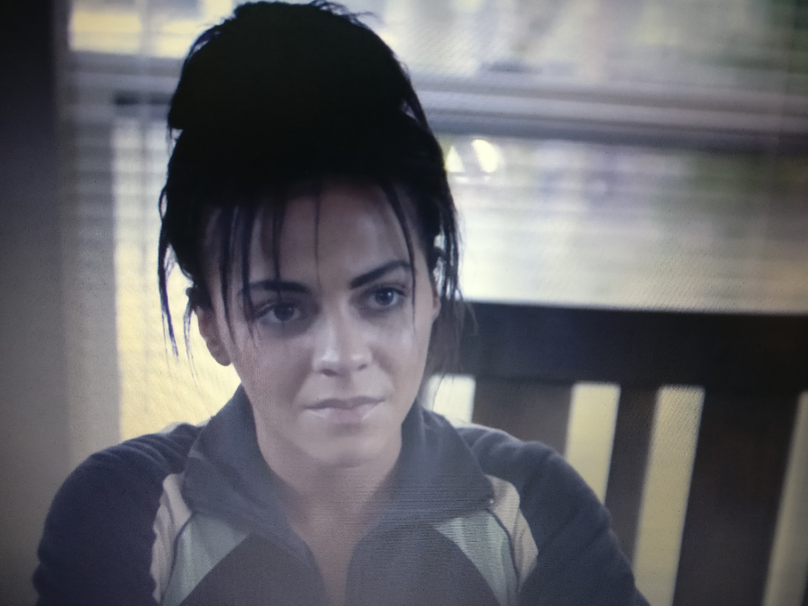
Pre-Service Training: Day 1
Activity Time: Deshawn Bleux Case
Asking the Right Questions
Notes:
Facilitator Notes:
Activity 1.13: Asking the Right Questions
Duration: 30 minutes
Goal: To help participants learn to formulate the right questions to determine a child’s
best interests.
Step 1: Briefly recaps the key facts in the Bleux case.
Inform the participants that their task is to consider all aspects of the circumstances so that they can make a recommendation. Ask them to write down questions they want to answer in
order to determine what is in Deshawn Bleux’s best interest. What information
do they need in order to make an informed recommendation?
Step 2: Ask the participants to make a list of questions they want to answer in order of priority. What
information is most important to gather first?

Slide 30

Pre-Service Training: Day 1
Working a Case
Bleux Case
10 days ago: Deshawn Bleux, a 2-month-old child who appeared to show symptoms of shaken baby syndrome, is admitted to the hospital. Father took child to the hospital when he could not be woken for his regular 10 pm feeding.
8 days ago: Child remains in the hospital with an injury more severe than previously thought.
Case Study
Notes:
Goal: To help participants learn to formulate the right questions to determine a child’s
best interests.
Step 1: Briefly recaps the key facts in the Bleux case.
Inform the participants that their task is to consider all aspects of the circumstances so that they can make a recommendation. Ask them to write down questions they want to answer in
order to determine what is in Deshawn Bleux’s best interest. What information
do they need in order to make an informed recommendation?
Step 2: Ask the participants to make a list of questions they want to answer in order of priority. What
information is most important to gather first?

Slide 31
Pre-Service Training: Day 1
Working a Case
Bleux Case
6 days ago: Deshawn to be released from the hospital and placed in foster care. Father, Miles Bleux, denies shaking the child.
5 days ago: Mother refused to say anything other than she was not home at the time of the incident.
Case Study
Notes:
Goal: To help participants learn to formulate the right questions to determine a child’s
best interests.
Step 1: Briefly recaps the key facts in the Bleux case.
Inform the participants that their task is to consider all aspects of the circumstances so that they can make a recommendation. Ask them to write down questions they want to answer in
order to determine what is in Deshawn Bleux’s best interest. What information
do they need in order to make an informed recommendation?
Step 2: Ask the participants to make a list of questions they want to answer in order of priority. What
information is most important to gather first?

Slide 32
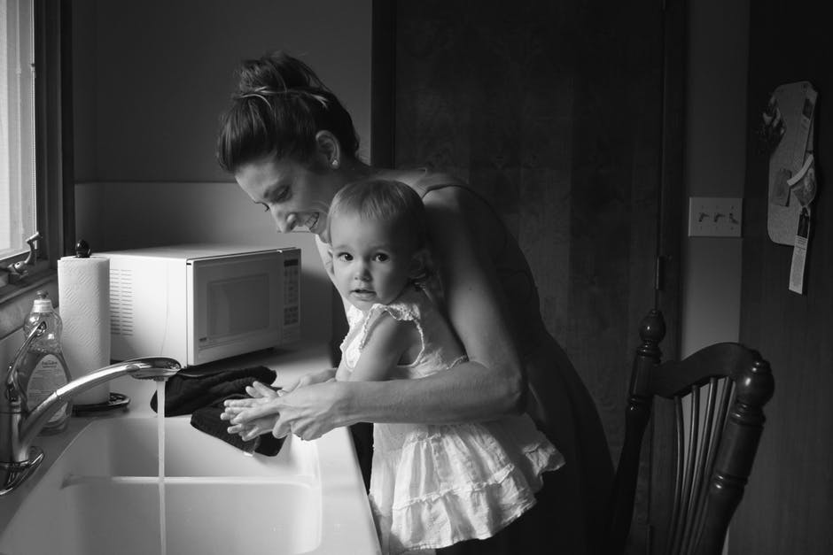
Pre-Service Training: Day 1
Permanence
Children require a primary attachment figure; an adult who can consistently meets their emotional and physical needs.
Notes:
Facilitator Notes:
A primary attachment figure is typically filled by a biological parent.
Other caring adults who commit unconditionally to the child can also meet the child’s need for permanence.

Slide 33

Pre-Service Training: Day 1
Permanence
As a CASA/GAL volunteer:
Advocate for a safe, permanent home as soon as possible, honoring the child’s culture & sense of time
Possible “permanent” options:
Return to parent
Adoption (by a relative or nonrelative)
Guardianship

Slide 34

Pre-Service Training: Day 1
Concurrent Planning- Adoption and Safe Families Act
Involves working on two solutions simultaneously:
  Solution One: To return the child home
  Solution Two: To find an alternative permanent placement
Moves a case more quickly through the system with better results
Is family-centered, with parents involved in decision making from the start
CASA/GAL volunteer explores all available options while providing culturally sensitive feedback to parents
Notes:
Facilitator Note
ASFA-

Slide 35

Pre-Service Training: Day 1
Adoption
What is Adoption?
  Parental rights are terminated or relinquished
  Grants the adoptive family the same parental rights that a biological parent would normally have
  Usually results in case and court closure
  Usually results in partial if not total separation from biological parents
Notes:
Facilitator Notes:

Slide 36
Pre-Service Training: Day 1
Kinship Guardianship
What is Guardianship?
  Subsidized alternative to adoption for children or youth who have been placed with relatives or approved caregiver
  Relatives and caregivers are certified resource parents
  Placement lasts six months or more
  Grants legal authorities that would otherwise be limited to parents
  Requires judicial approval to dissolve
Notes:
Facilitator Notes:

Slide 37

Pre-Service Training: Day 1
Lunch Break

Slide 38
Pre-Service Training: Day 1
Case Studies
During this next activity be prepared to:
Put on your investigator hat
Critically think about content relevance as you read interviews
Ask your self “what difference does this make for my case?”
Think creatively and outside the box on who to speak with when working your case
Allow other members in your group to speak up and voice their opinions as well

Slide 39

Pre-Service Training: Day 1
Case Studies
Greene Case Study
Notes:
Recap and discuss the Greene case and have the majority vote decide who to interview.
Have one facilitator run the slides, pausing the shared screen so the audience only sees the desired interview.

Slide 40
Pre-Service Training: Day 1
Working a Case
Greene Case
2 Weeks ago: A call was made to the CPS hotline by the kindergarten teacher and school nurse at Parkside Elementary.
The callers stated that one of their students, Marky Greene, often comes to school with poor hygiene, that much of his clothing is not his size, and that he’s just come in with his third case of head lice in three months.
Case Study
Notes:
Facilitator Notes
Request the participants to read the key facts in the Greene case.
Ask them to write down questions they want to answer in order to determine what is in Marky’s best interest.
Ask them what information they require in order to make recommendations.

Slide 41
Pre-Service Training: Day 1:
Working a Case
Greene Case
The family is Caucasian; the parents are in their late twenties. The mother is diagnosed with bipolar disorder.
The Greene family moved recently from a few states away. They have no extended family living nearby.
SW found conditions in the home deplorable but not dangerous. CPS decided to file a petition for neglect but to allow the child to remain at home for the time being.
Case Study

Slide 42
Pre-Service Training: Day 1
Case Studies – Debrief
Greene Case Debrief Questions:
• What did you think of the decision to provide in-home services rather than removing the child from the home?
• What is the minimum level of progress needed for the child to stay in the home after three months?
• Did you recommend that the parents be required to improve the physical conditions of the home? Why or why not?
• How did the mental health needs of the parents affect the way you approached this case?
• After the psychological evaluation, how is the family going to come up with money for any treatment prescribed?
• Were some interviews more beneficial than others? How would you prioritize the people you want to interview?
• What other agencies might the child protection agency collaborate with on this case? Are there other community services that can be involved to assist?

Slide 43
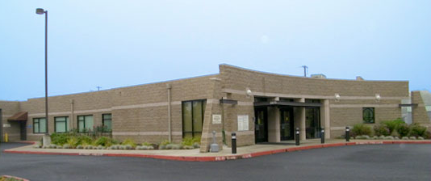
Pre-Service Training: Day 1
Court Proceedings
Etiquette Rule No. 1: The judge not only represents the ultimate authority in the court, but also the law. This is why when a person addresses the court, the judge is the main focal point.

Slide 44
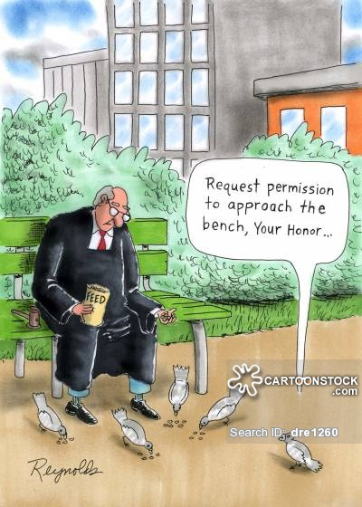
Pre-Service Training: Day 1
Court Proceedings - Etiquette
Wear clothing that would be appropriate for business. (no jeans)
Arrive early and be ready to go through security check.
Turn off electronic devices and cell phones before entering the courtroom.
Be polite to the judge, opposing counsel, and court staff.
Rise when the judge enters and leaves the courtroom.
Stand when speaking to the judge.
Do not interrupt others while they are talking.
Refer to the judge as “Your Honor.”
No food or drinks permitted in the courtroom.

Slide 45


Pre-Service Training: Day 1
Court Proceedings - Etiquette

Slide 46

Pre-Service Training: Day 1
Who Participates in a Case?
The Child
CASA Volunteer
Attorney for the Child
Parents/Caretakers Named in the Petition
Attorney for the Parent/Caretaker
DHS Caseworker
D.O.j.
Indian Child’s Tribe (if applicable)
judge
PARTICIPATES
Notes:
Handout: Handout the court layout diagram as well as the court report writing documents.

Slide 47
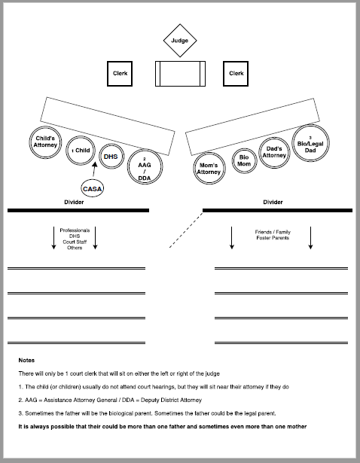
Pre-Service Training: Day 1
Who Participates in a Case?
Notes:
Handout: Handout the court layout diagram as well as the court report writing documents.

Slide 48
Pre-Service Training: Day 1
Court Report: Confidentiality Flowchart
Is it in the child’s best interest to share this information?
NO
Do not share the information. Contact CASA program staff
NO
YES
Resist sharing the information. Is the person legally entitled to it?
Is it my information to share?
YES
Contact CASA program
staff.
NO
Direct the person asking to the original source.
YES
Is the person legally entitled to the information?
NO
YES
Tell the person that he or she will need to obtain a court order
Share the information.

Slide 49
Pre-Service Training: Day 1
Introduction to the Court Report
Most essential aspect of your work.
The vehicle you use to present information you have gathered.
Visible documentation of your involvement in the case.
Judges rely on these reports to make informed decisions.
All CASA/GAL programs require submittal of court reports.

Slide 50

Pre-Service Training: Day 1
Court Report: Court Report Template
Notes:
Have participants look at the court report template which was handed out to them. Review the template step by step and give descriptions and examples for what kind of information will go in each section.

Slide 51
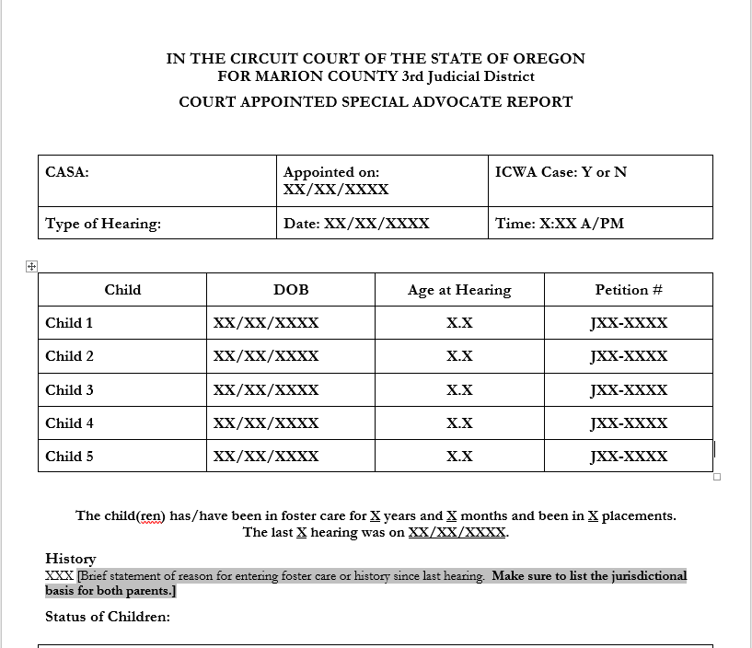

Slide 52
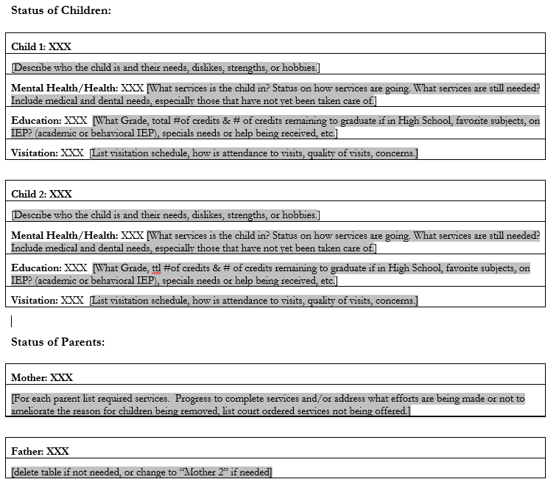

Slide 53
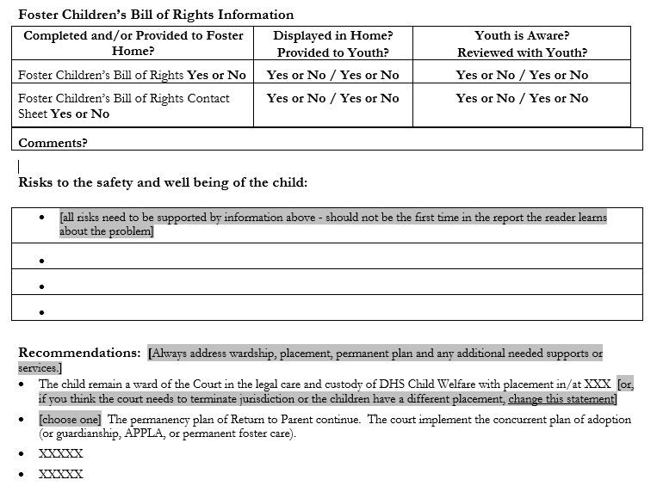

Slide 54
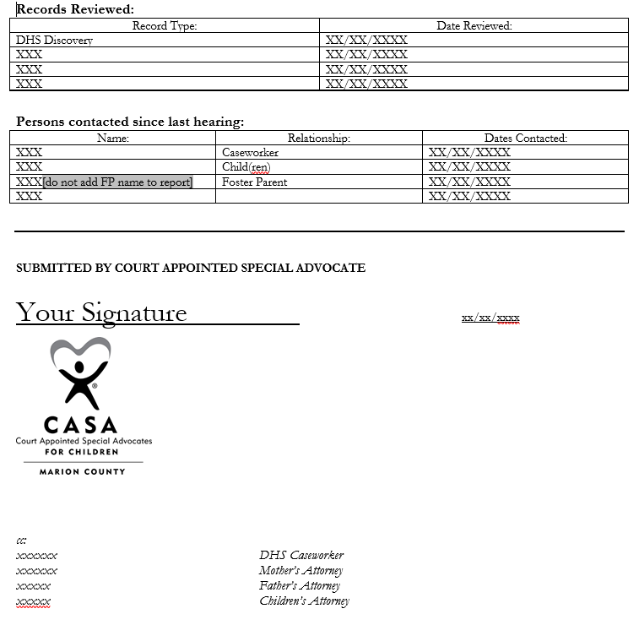

Slide 55
Pre-Service Training: Day 1
Court Report: Defining the Terms
Objective
Subjective
Notes:
Discuss the difference between objective and subjective court report material. Court reports need to be fact based and objective in nature.
Subjective court material would be information that stems from your opinion, that has factual holes which are filled with speculation and that could insinuate ideas that are not absolute. Whereas objective court material will contain facts and absolutes that leave the reader the ability to form their own conclusions.
Example 1:
Subjective: The mother does not want to stop using drugs and has no interest in continuing her treatment. She repeatedly missed her drug and alcohol appointments and has made no progress.
Objective: The mother has attended 2 out of the last 13 drug and alcohol appointments. Her drug and alcohol counselor reported that she has not been able to get ahold of the mother and reported that the mother would often show up late, leave early and not participate in any group discussions when she has attended.

Slide 56
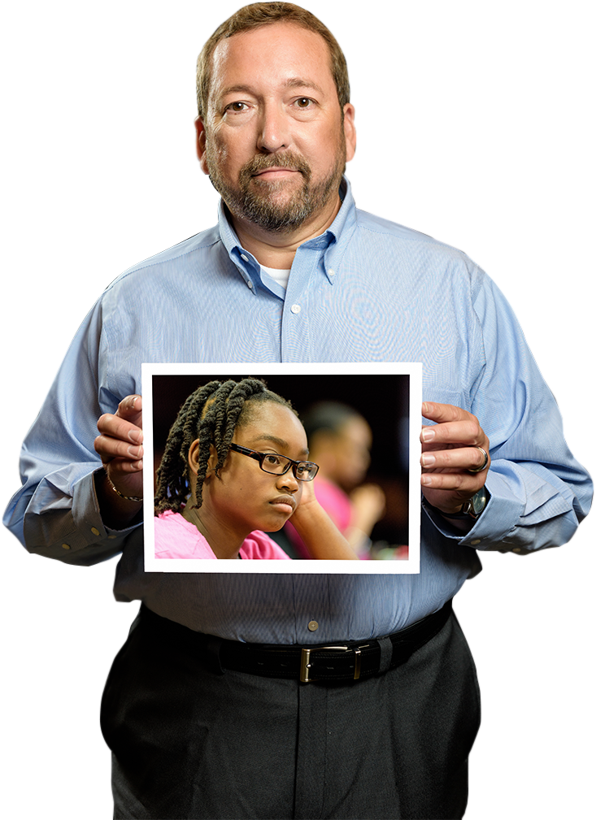
Pre-Service Training: Day 1
Court Report: The “Best Interest” Principle
2E
The CASA volunteer is guided by the “best interest” principle when advocating for a child:
  Know the child well enough to identify the child’s needs.
  Make fact-based recommendations to the court about appropriate resources to meet those needs.
  Inform the court of the child’s wishes, whether or not those wishes are, in your opinion, in the child’s best interest.

Slide 57

Pre-Service Training: Day 1
Court Report: The “Best Interest” Principle
2E
Questions to Ask Yourself:
  Is the child safe?
  Is the child’s unique culture being respected?
  What are the special needs of this child?
  Is the child’s sense of time being honored?
  Is the child receiving the emotional nurturance necessary for healthy brain development?
  Can this child speak for himself/herself?
  Should the child be present in court?

Slide 58
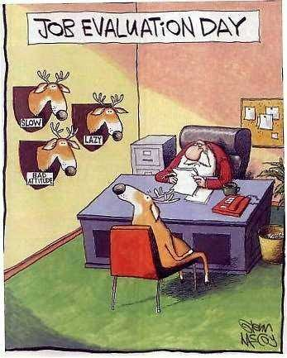
Pre-Service Training: Day 1
Training Evaluation
Please fill out the volunteer training evaluation and give it to the facilitator.

Slide 59

Pre-Service Training: Day 1
Wrap Up
Next In Person Training
Guest Speakers
Court observations
Swearing-In Ceremony invites.

Slide 60
Lift up a child's voice
A child's life.™
THE NATIONAL CASA PRE-SERVICE VOLUNTEER TRAINING
Version 2, Nov 2017

Slide 61

Pre-Service Training: Day 2
Welcome
Please share one concept that has been the most interesting to you so far in this training and why.

Slide 62
Pre-Service Training: Day 2:
Feelings Thermometer
In their training for parents caring for children who have experienced trauma, NCTSN writes:
The Feelings Thermometer . . . [can] make you more aware of the topics or situations that push your buttons, and how you react when your buttons are pushed. With this awareness, you may be able to anticipate situations that are going to raise your emotional temperature, and come up with a game plan for coping with them. When your Feelings Thermometer goes way up that means you’re feeling stressed, anxious and feel the need to escape. You also may find that when you become very uncomfortable, you “space out” and withdraw from the discussion. Spacing out or withdrawing is something that traumatized kids do sometimes as well. What looks like boredom, or just not caring, or withdrawal can sometimes be a reaction to trauma.
NCTSN, Caring for Children Who Have Experienced Trauma, February 2010.
Notes:
Activity 3.8: Preparing to Talk About Trauma
Goal: To anchor the topic of trauma in participants’ own knowledge and help them be aware of how their life histories may affect their advocacy.
Step 1: Choose a participant to read the paragraph on the trauma and the Feelings Thermometer. Then the facilitator reads the next slide.

Slide 63
Pre-Service Training: Day 2:
Feelings Thermometer
As you begin to explore the topic of trauma, be aware that your feelings about any personal trauma you or someone you are close to has experienced may be heightened. If you find that your “feelings thermometer” is running high and it may be affecting your role as an advocate, please address your concerns with CASA/GAL program staff.
Notes:
Step 2 (cont’d from previous slide)
Facilitator reads this slide.

Slide 64

Pre-Service Training: Day 2:
Feelings Thermometer
Very uncomfortable
Extremely stressed and anxious
Need to get out of here now
VERY HOT
Moderately uncomfortable
Stressed and anxious
Distracted and edgy
HOT
Mildly uncomfortable
Slightly stressed and anxious
Losing my focus
WARM
Comfortable
Not stressed or anxious
Focused and engaged
JUST RIGHT
A little bored
Losing my focus
COOL
Totally bored
Not focused or engaged
Planning my escape
ICE COLD
Notes:
Activity 3.8: Preparing to Talk About Trauma
Duration: 5 Minutes
Goal: To anchor the topic of trauma in participants’ own knowledge and help
them be aware of how their life histories may affect their advocacy.
Step 1: Have participants read the paragraph on Trauma and the Feelings
Thermometer below.
Step 2: Show the Feelings Thermometer and briefly introduce this concept.
Emphasize that participants need to be aware of their reaction to trauma and to
any personal experience with trauma.
Discuss issues in the context of the feelings thermometer. What issues trigger
participants? What should be done when issues trigger CASA/GAL volunteers?
Encourage participants to talk to program staff if they feel their advocacy role
may be affected by experiences with trauma.

Slide 65
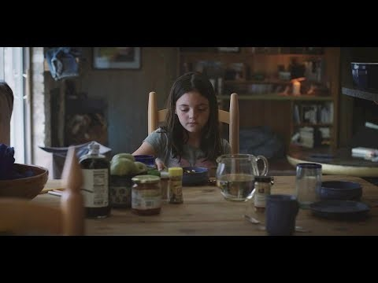

Slide 66

Pre-Service Training: Day 2
Seeing the Whole Child
Five categories of needs that all people have:
  These needs generally have to be met in sequence from the first level on up.
  If the needs at one level are not met, the needs at the next level are much more difficult to meet.

Slide 67
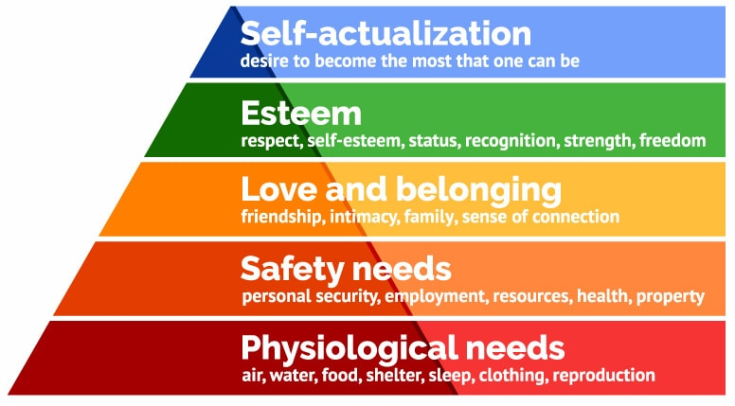
Pre-Service Training: Day 2
Maslow’s Hierarchy of Needs
Notes:
Facilitator Notes:
Discuss how this is a fluid experience, people will move up and down this chart on any given day– think of how this may impact a traumatized child.
There are five categories of needs that all people have:
These needs have to be met in sequence from the first level on up
If the needs at one level are not met, the needs at the next level cannot be met
The most basic for survival
Protection and security needs are also important for survival
Needs become increasingly psychological and social such as the need to experience love and belonging

Slide 68
Pre-Service Training: Day 2
Minimum Sufficient Level (MSL) of Care
Factors to be considered to ensure MSL:
  Physical, emotional and developmental needs are met
  Parent’s behavior complies with accepted child-rearing practices
  Parent’s behavior falls within reasonable limits of the community
Notes:
Facilitator Notes:
Talk about how removing a child from his or her home is traumatic for the child.
Children should be removed only when parents cannot provide the minimum sufﬁcient level of care

Slide 69
Pre-Service Training: Day 2
Children’s Needs and Development
Minimal Sufficient Level (MSL) of Care
What do children really need? College? Clothes? A bath every day?
How might a child’s needs vary depending on his/her circumstances?
What issues should be considered in determining whether a parent can provide a minimum sufficient level of care?
How do you think the MSL standard benefits children?
Notes:
Facilitator Notes:
Pose the questions on the slide to the class. Initiate conversation to aid the class in understanding the gravity of MSL and how it applies to CASA’s work in a child’s life.

Slide 70


Pre-Service Training: Day 2
Oregon Safety Model
The Oregon Safety Model is the objective standard by which ODHS Child Welfare works to ensure child safety. This model covers how a case should be treated throughout its life. A few topics covered in the OSM are:
Present and Impending Danger
Protective Action Plans
Conditions of Return
Protective Capacities
Confirming Safe Environments
Ongoing Safety Planning
https://www.google.com/url?sa=i&url=https%3A%2F%2Fchildwelfaremonitor.org%2Ftag%2Foregon-safety-model%2F&psig=AOvVaw2EJKQmKIfwVx7FJpn7DroW&ust=1618615333121000&source=images&cd=vfe&ved=2ahUKEwjbnPiQsoHwAhUUJjQIHQKgA5UQr4kDegQIARB2

Slide 71

Pre-Service Training: Day 2
Oregon Safety Model
It should be noted that ODHS must abide by this model and there will be times were ODHS will pursue a course of action that may be in opposition to CASA.
https://www.guardianpharmacyatlanta.com/2018/08/06/how-do-i-deal-with-all-of-these-regulations/
While CASA operates on what is in the best interest of the child, ODHS has to function off of additional legal obligations.
The Oregon Safety Model works to create circumstantial safety while also guiding caseworkers in trying to eliminate safety threats.
Notes:
In short: A child can and should be returned to a home from which they were removed as long as parameters are set in place to mitigate safety concerns. This often looks like a Safety Service Provider in the home (SSP) to manage safety. This could also be face to face check ins, enhanced services, phone call check-ins and many other creative solutions. Parents do not have to meet expected outcomes prior to in-home plans.
While CASA is free to recommend and advocate for what we think is best, it should be noted that it is the mission of the state and should be the mission of the CASA to get the child in home with their caregivers as long as it does not pose harm to the child’s safety and wellbeing.
ODHS must consider findings, funding, OSM, and service, resource and resource home availability when making some decisions, though safety should be the primary factor.

Slide 72
Pre-Service Training: Day 2
The Attachment Cycle
The cycle of consistently meeting a child’s needs creates a secure attachment between the infant and caretaker
The cycle may be disrupted or inconsistent for many of the children in the child protection system
Need
Signals
Discomfort
Security
Trust
Attachment
Signals
Comfort
Satisfaction
Of Need
Notes:
Facilitator notes: Express and response (serve and return) of infant who is hungry (Example)

Slide 73
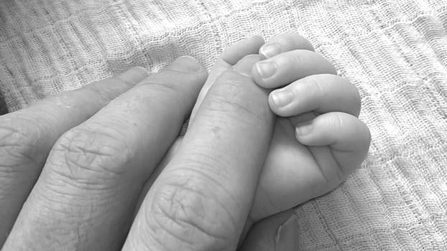
Pre-Service Training: Day 2
Attachment
A strong, enduring bond of trust that develops between a child and the person(s) he/she interacts with most frequently
Learning to attach is influenced by:
  The child’s genetic predisposition
  The conditions under which the child is cared for
  The child’s parent or caretakers
Notes:
Facilitator Notes:
A strong, enduring bond of trust that develops between a child and the person(s) he/she interacts with most frequently develops intensely through the first three years of life and becomes more difficult to develop after age 3.

Slide 74

Pre-Service Training: Day 2
A Child’s Needs & the Volunteer’s Role
As a volunteer advocate:
The child’s needs - food, shelter, and clothing - are paramount
Healthy growth and development depend on adequately meeting basic needs

Slide 75
Pre-Service Training: Day 2
A Child’s Needs & the Volunteer’s Role
As a volunteer advocate:
Children’s needs depend on their age, stage of development, attachment to their family/caregivers and reaction to what is happening around them
Your role is to identify the child’s unmet needs and to advocate for those needs to be met

Slide 76

Pre-Service Training: Day 1
Activity Time: Ages and Stages
Let’s guess the right age!
Notes:
Activity 2.18: Ages and Stages
Facilitator Notes: Ages and Stages handouts can be found in the binder

Slide 77
Birth to 6 Months | 6 to 12 Months | 12 to 18 Months
18 Months to 3 Years | 3 to 5 Years | 6 to 9 Years
10 to 15 Years | 16 to 21 Years
Head is not very steady
Feels totally dependent on primary caregiver
Understand the meaning of no
First learns to clench hands
Can roll over
Can say “mama”, “dada” and two to three other words
Play by themselves
Fear of authority figures
Begins to walk
Can turn pages of a book, two or three at a time
Boys first have erections
Holds cup with two hands
Can say first name
Smiles at primary caregiver
Stretches arms to be picked up
Can point to the things he/she wants
Can ride a tricycle
Self-esteem is dependent on authority figures
First learning to cooperate
Early sex role development
Buttons and unbuttons large buttons
Knows what authority figures want
Can use a spoon
Begins to follow peers’ fads
Has a vocabulary of 1000 words
Can use a toilet independently
Can think using symbols
Can tie shoe
Can cut with scissors
Chooses own friends
Can throw a ball
Has an extensive vocabulary but cannot sequence
Can run
Knows common opposites
Couples pair off into stable sexual relationships
Heightened physical power, strength and coordination
Understand hypothetical situations
Uses formal logic and can change sides in a debate
Greater physical coordination, manual dexterity, growth patterns vary widely
Girls develop faster than boys
Feels awkward about his/her body
Conflict with parents begin to decrease
Increased capacity for tender and sensual love
Feelings of love and passion begin to emerge
Notes:
Have everyone grab a piece of paper and access the Drop Box to retrieve the Ages and Stages Child Development Chart. In work groups, have participants assign the ages with the stages found on the next slide.

Slide 78
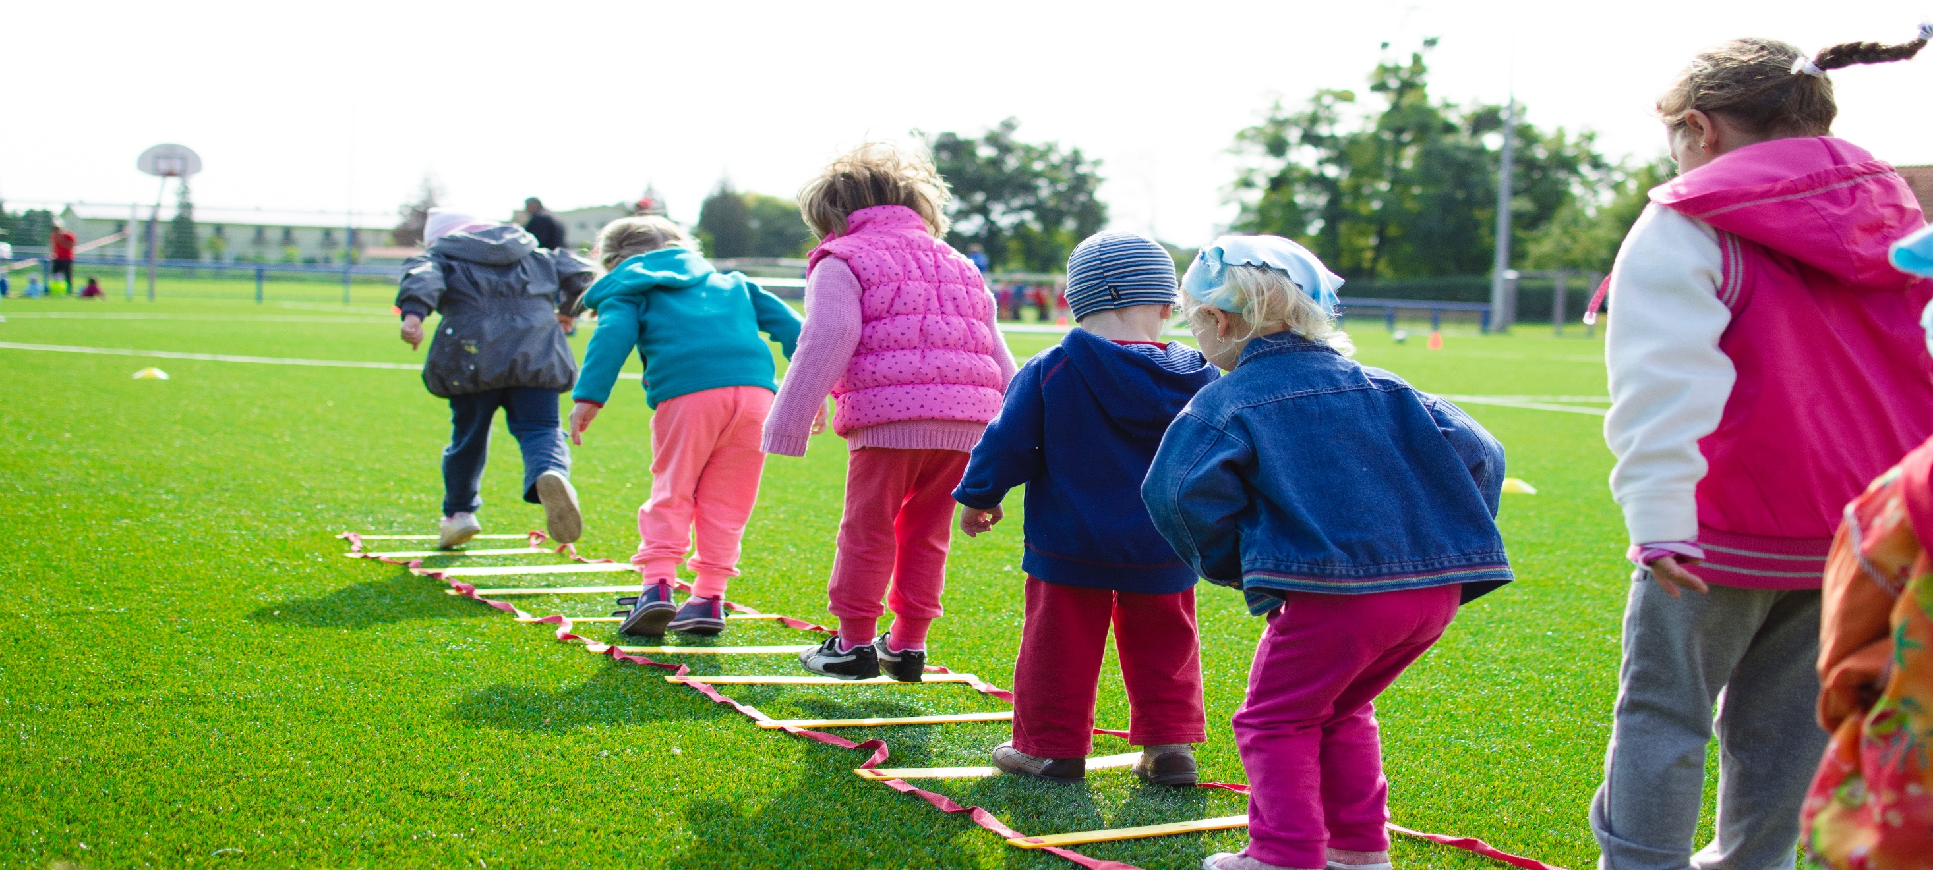
Pre-Service Training: Day 1
How Children Grow and Develop
When observing a child’s development, keep in mind these key points:
There is a wide range of typical behavior. At any particular age 25% of children will not exhibit the behavior or skill, 50% will show it, and 25% will already have mastered it.
Some behaviors may be typical—in the sense of predictable— responses to trauma, including the trauma of separation as well as abuse and neglect.
Prenatal and postnatal influences may alter development. Other factors, including culture, current trends and values, also influence what is defined as typical.
As a CASA/GAL volunteer, you need to become aware of your values, attitudes and perceptions about what is typical in order to be more objective and culturally sensitive when assessing a child’s needs.
Notes:
Facilitator Notes:
Additional Information
How Children Grow and Develop
No two children are alike. Each one is different. Each child is a growing, changing person.
Children are not small adults. They do not think, feel, or react as grown-up people do.
Children cannot be made to grow. On the other hand, they cannot be stopped from growing.
Even though children will grow in some way no matter what care is provided for them, they cannot reach their best growth possibilities unless they receive care and attention appropriate for their stage of development from a consistent figure in their life.
Most children roughly follow a similar sequence of growth and development. For example, children scribble before they draw. But no two children will grow through the sequence in exactly the same way. Some will grow slowly while others grow much faster. Children will also grow faster or slower in different areas of development. For example, a child may be very advanced in language development but less advanced, or even delayed, in motor coordination.
During the formative years, the better children are at mastering the tasks of one stage of growth, the more prepared they will be for managing the tasks of the next stage. For example, the better children are able to control behavior impulses as 2-year-olds, the more skilled they will be at controlling behavior impulses they experience as 3-year-olds.
Growth is continuous, but it is not always steady and does not always move smoothly forward. You can expect children to slip back or regress occasionally.
Behavior is influenced by needs. For example, active 15-month-old babies touch, feel and put everything into their mouths. That is how they explore and learn; they are not intentionally being a nuisance.
Children need to feel that they are loved, that they belong, that they are wanted. They also need the self-confidence that comes from learning new things.
Experiences offered to children need to fit their maturity level. If children are pushed ahead too soon, and if too much is expected of them before they are ready, failure may discourage them. On the other hand, children’s growth may be impeded if parents or caregivers do not recognize when they are ready for more complex or challenging activities. Providing experiences that tap into skills in which children already feel confident as well as offering some new activities that will challenge them gives them a balance of activities that facilitates healthy growth.

Slide 79
Pre-Service Training: Day 2:
Types of Trauma
Acute
Chronic
Complex
Historical
Notes:
Facilitator Notes:
When a child witnesses or experiences an event that poses a real or perceived threat to the life or well-being of the child or someone close to the child.
The event causes feelings of fear, helplessness or horror
The child is unable to cope with the intense feelings
Complex trauma describes both children's exposure to multiple traumatic events—often of an invasive, interpersonal nature—and the wide-ranging, long-term effects of this exposure. These events are severe and pervasive, such as abuse or profound neglect
Acute trauma is a onetime event that happens under a limited amount of time. This. could be like a sexual or physical assault, going through a natural disaster or possibly car wreck. Chromic trauma is where an event may happen over and over and over again or it.
Chronic trauma is trauma that is repetitive, and occurs over an extended period of time. Examples of chronic trauma can include such things as domestic violence, childhood abuse, and war
Historical trauma (HT), as used by social workers, historians, and psychologists, refers to the cumulative emotional harm of an individual or generation caused by a traumatic experience or event. Historical Trauma Response (HTR) refers to the manifestation of emotions and actions that stem from this perceived trauma.

Slide 80

Pre-Service Training: Day 2:
How to Determine Trauma in a Child?
Has the child experienced early and repeated exposure to overwhelming events?
Is the child having difficulty controlling behavior?
Is the child having difficulty with sustaining attention, concentration, or learning?
Is the child showing persistent difficulties in relationships with others?
Does the child have difficulty regulating bodily states and emotions?
Does the child have multiple mental health diagnoses without any one sufficiently explaining his/her problems?
Notes:
Facilitator Notes: Inform the participants that the questions written on the slide can help them determine whether to recommend a trauma assessment.

Slide 81

Pre-Service Training: Day 2:
Shane’s Story
Notes:
youtActivity 3.9 - Child Trauma (Cont.)
Facilitator Instructions:
Click on the image on screen in slide show mode to play the video.
https://www.youtube.com/watch?time_continue=3&v=mXyM5KvGx3w
Step 2: Ask participants to recall the “Shane’s Story” video that they watched. Ask participants to discuss the various types of trauma that Shane experienced before and after entering the child protection services system. Shane’s experiences included domestic violence (wrestling matches between his mom and dad), physical abuse from his dad, substance abuse in the home, medical care trauma (held down for
a shot), his dad’s death from alcohol, his mom’s depression, his removal from his parents and the storm. (10 minutes)

Slide 82
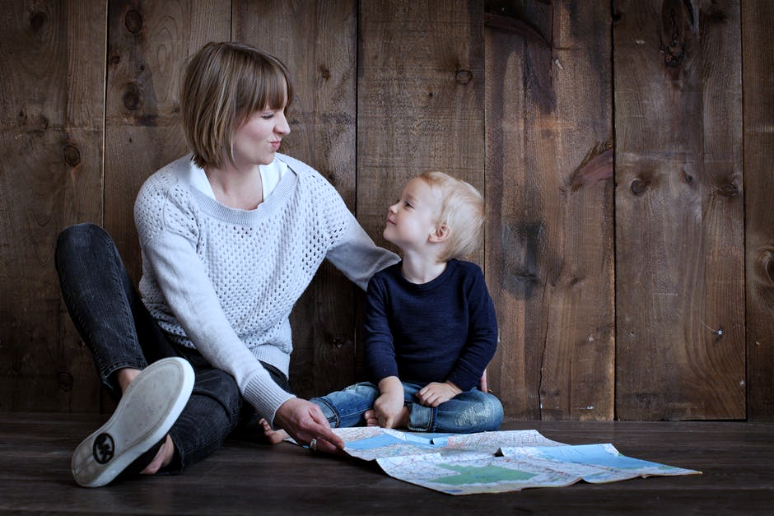
Pre-Service Training: Day 2:
Tips for CASA Volunteers
Treat children as individuals not victims
Consider the child’s past experiences
You may request a trauma screening for the child
Parents may have unresolved trauma histories
Parents also may undergo a trauma screening
Notes:
Facilitator Notes:
Additional Information to be shared in class:
When a child witnesses or experiences an event that poses a real or perceived threat to the life or well-being of the child or someone close to the child.
The event causes feelings of fear, helplessness or horror
The child is unable to cope with the intense feelings
CASA Volunteers need to consider:
The child’s age or developmental stage
The child’s perception of the danger faced
Whether the child was a victim or a witness
The child’s relationship to the victim or perpetrator
The child’s past experience with trauma
The adversities the child faces following the trauma
The availability of adults who can offer help & protection

Slide 83
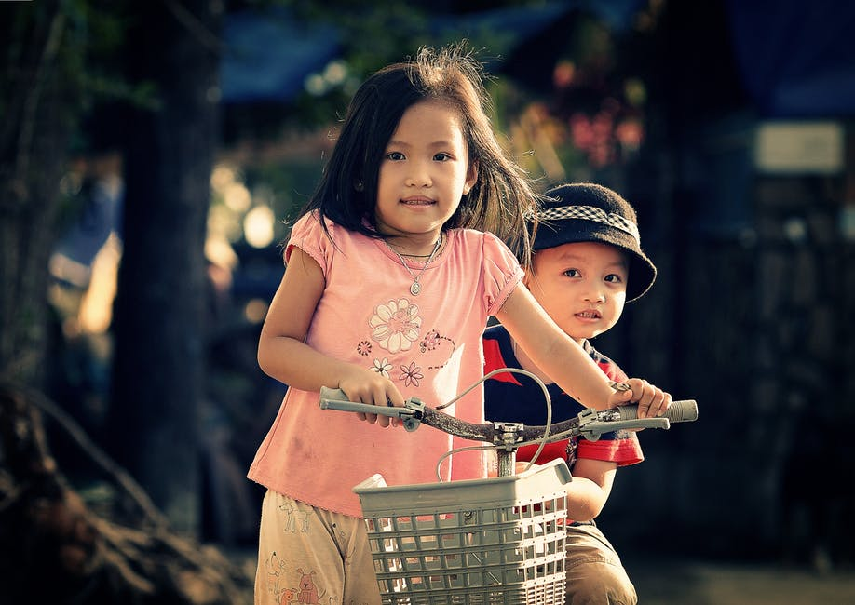

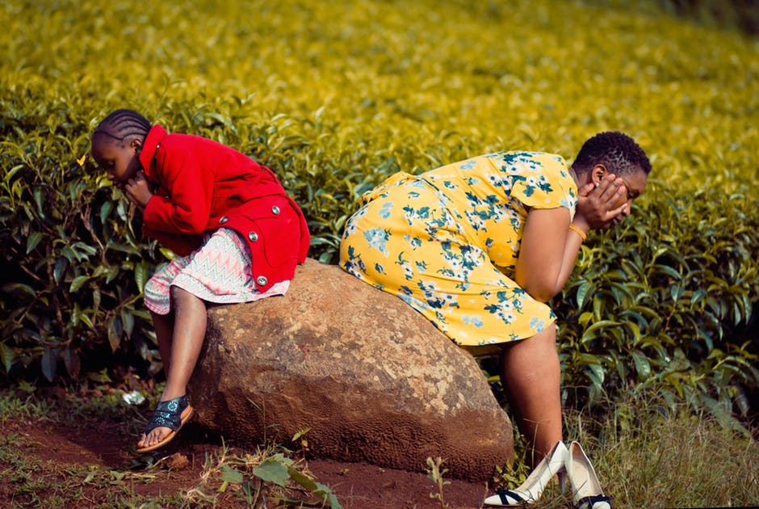

Pre-Service Training: Day 2:
Adverse Childhood Experience (ACE)
Children experience trauma if removed from their home
Each new placement increases irreversible damage to their emotional and psychological health
When removed from homes, they feel isolated and detached
For safety, sometimes they must be moved

Slide 84
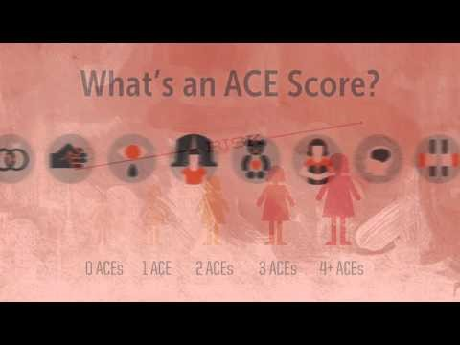
Pre-Service Training: Day 2
ACEs

Slide 85
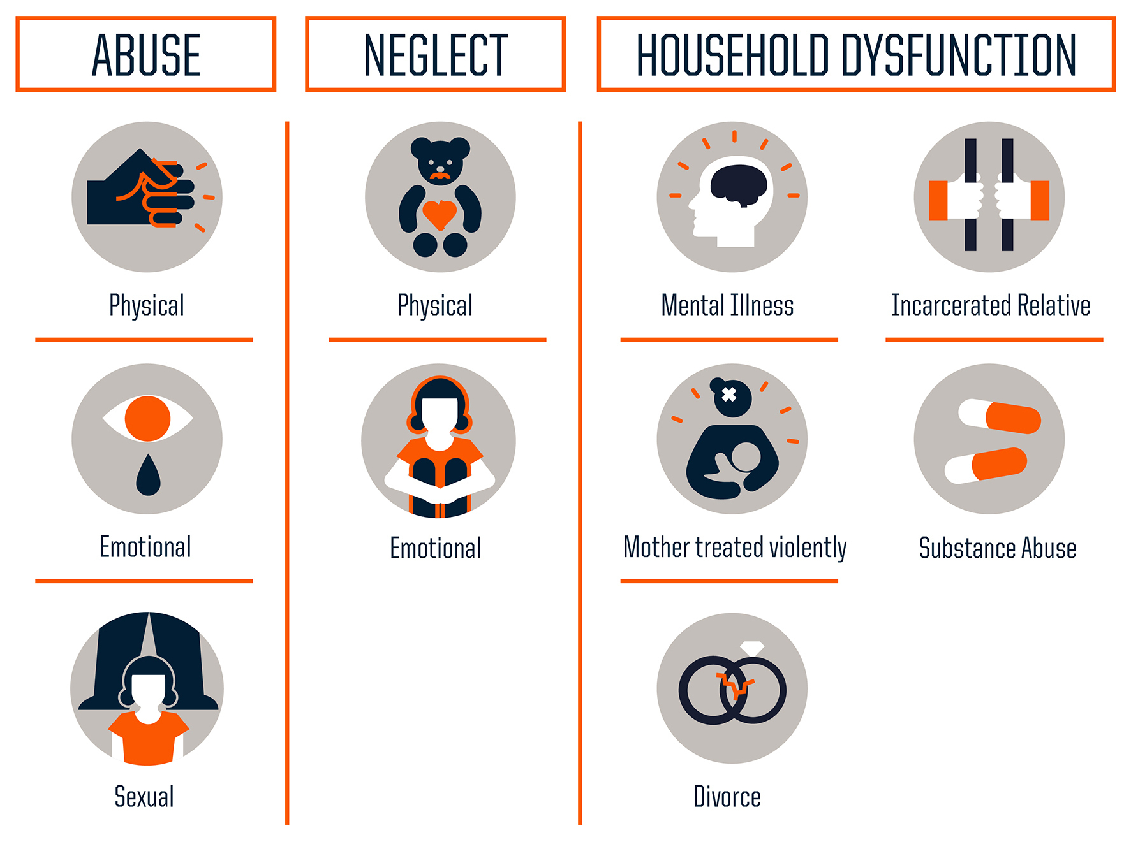
Pre-Service Training: Day 2
ACEs
3B
3F
8D

Slide 86
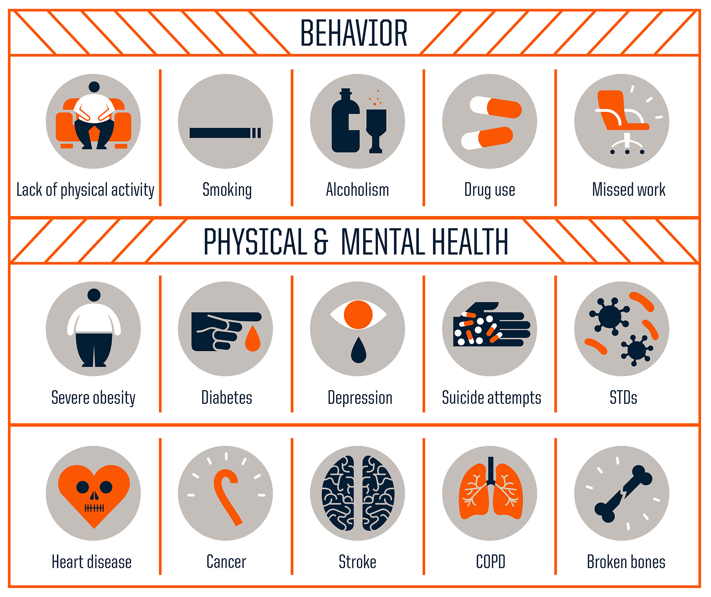
Pre-Service Training: Day 2
ACEs
3B
3F
8D

Slide 87
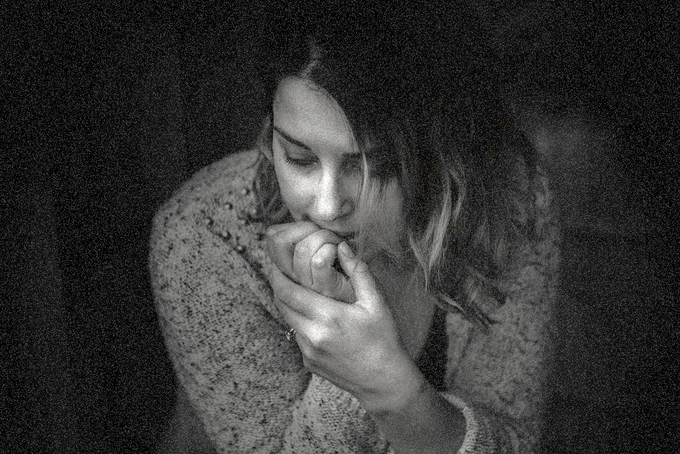
Pre-Service Training: Day 2:
Activity Time: Long-Term Effects of Childhood Trauma
What long-term effects might the unresolved trauma have on a child’s health and well-being?
What ACE score do you think Clarissa Redd might have, given her early childhood experiences?
Notes:
Activity 3.10 - The Long-Term Effects of Childhood Trauma
All trainees have read through the Redd case in week 5. They can find the case outline and interviews in their drobox for reference. Have the class discuss what Clarissa Redd might have given her early childhood experience. We do not know the answers to every question but many are alluded to.
Note: When participants consider an ACEs score, they may start considering their own score. Don’t ask participants to share their personal scores, but let them know that it’s natural to think about their own score and where it falls on the chart. Be aware of participants who may be struggling with trauma issues that could affect their work as a CASA/GAL volunteer.

Slide 88
Pre-Service Training: Day 2
ACEs – Finding your ACE Score
3B
3E
While you were growing up, during your first 18 years of life:
1. Did a parent or other adult in the household often …
Swear at you, insult you, put you down, or humiliate you?
or
Act in a way that made you afraid that you might be physically hurt?
Yes No If yes enter 1 ________
2. Did a parent or other adult in the household often …
Push, grab, slap, or throw something at you?
or
Ever hit you so hard that you had marks or were injured?
Yes No If yes enter 1 ________
3. Did an adult or person at least 5 years older than you ever…
Touch or fondle you or have you touch their body in a sexual way?
or
Try to or actually have oral, anal, or vaginal sex with you?
Yes No If yes enter 1 ________
4. Did you often feel that …
No one in your family loved you or thought you were important or special?
or
Your family didn’t look out for each other, feel close to each other, or support each other?
Yes No If yes enter 1 ________
5. Did you often feel that …
You didn’t have enough to eat, had to wear dirty clothes, and had no one to protect you?
or
Your parents were too drunk or high to take care of you or take you to the doctor if you needed it?
Yes No If yes enter 1 ________
6. Were your parents ever separated or divorced?
Yes No If yes enter 1 ________
7. Was your mother or stepmother:
Often pushed, grabbed, slapped, or had something thrown at her?
or
Sometimes or often kicked, bitten, hit with a fist, or hit with something hard?
or
Ever repeatedly hit over at least a few minutes or threatened with a gun or knife?
Yes No If yes enter 1 ________
8. Did you live with anyone who was a problem drinker or alcoholic or who used street drugs?
Yes No If yes enter 1 ________
9. Was a household member depressed or mentally ill or did a household member attempt suicide?
Yes No If yes enter 1 ________
10. Did a household member go to prison?
Yes No If yes enter 1 ________
Now add up your “Yes” answers: _______ This is your ACE Score
Notes:
If you wish for participants to take the ACE test for themselves or to apply it to the Redd case – this template can be used.

Slide 89
Pre-Service Training: Day 2:
Resilience
Resilience is very individual
Some children are naturally more resilient than others
Resilience can be built & enhanced through practice
Notes:
Facilitator Notes:
Considerable research has shown that child abuse and neglect increase the likelihood of developing problems later, but not all children subjected to lives of severe adversity go on to become dysfunctional adults. Some don’t experience problems or do so to only a minor degree. This is resilience: the ability to become strong, healthy or successful again after something happens. Resilient people overcome the ravages of poverty, abuse, unhappy homes, parental loss, disability or any of the other risk factors known to set people on a difficult course in life. Resilient children achieve normal development despite their experience of past or present adversity.
Studies of resilient people have repeatedly identified the presence of certain protective factors: personal qualities, family, relationships, outlooks and skills that assist them in overcoming hardships and finding success. Helping children and youth, in the child welfare system, discover and/or develop some of these characteristics, can significantly improve their chances for positive life outcomes

Slide 90
Pre-Service Training: Day 2:
Resilience
  Competence
  Confidence
  Connection
  Character
  Contribution
  Coping
  Control
Notes:
• Resilience is individual.
• Some children are naturally more resilient than others.
• Resilience can be built and enhanced through practice.
Share an example of each of the “Seven Cs” with participants. In pairs, have participants choose one of the “Seven Cs” and answer the following question:
• How can you help to build or reinforce this characteristic in a child you work
with as a CASA/GAL volunteer? (8 minutes)
Step 3: (Optional) It is recommended that an outside expert from the community comes in and shares more about their knowledge of and experiences with trauma and resilience. Ask the participants to discuss any questions after the presentation.

Slide 91

Pre-Service Training: Day 2
Case Studies: Redd Case
Redd Case Debrief

Slide 92
Pre-Service Training: Day 2:
Working a Case
Redd Case
The local hospital notified CPS of an infant born on 2/1 who tested positive for PCP
The infant, named Mariah Redd, is the third child born to Clarissa Redd
She was removed from the care of Clarissa Redd and placed in foster care with Julia Budd
When Mariah was 2 months old, she and Clarissa went to Fresh Start, a mother/baby residential treatment program
Case Study
Notes:
Facilitator Notes
Ask the participants to read the key facts in the Redd case.

Slide 93
Pre-Service Training: Day 2:
Working a Case
Redd Case
Ms. Clarissa Ann Redd, African American, age 25, reported to SW that she has been using “sherm” (cigarettes dipped in PCP) on and off since she was 18
She has a 10 year-old son, Buddy, who is in the legal custody of her mother, Lela Jones. Lela is married to Clarissa’s stepfather, Charles Jones
Clarissa’s second child, a 7-year-old boy named Tyrone, lives with his father, Willy Monroe
Case Study
Notes:
Facilitator Notes
Ask the participants to read the key facts in the Redd case.

Slide 94

Pre-Service Training: Day 2:
The Redd Case
What were two or three of the top issues that needed to be addressed?
What were some of the major challenges you faced as you made your way through this case on your own?
What are some additional questions you might have posed to some of the key players in the case?
What recommendations did you make for this case?
Did anything surprise you about this case?
Notes:
Activity 5.3: Redd Case Debrief
Goal: To ensure that volunteers can demonstrate information gathering methods,
and to assess their level of skill in making recommendations autonomously.
Discuss the court report writing experience. As a class discuss:
What were two or three of the top issues that needed to be addressed in the Redd case?
What were some of the major challenges you faced as you made your way through this case on your own?
What are some additional questions you might have posed to some of the key players in the case? How would these questions have helped your information gathering for this case?
What recommendations did you make for this case? Did anyone in your group have recommendations that you didn’t make? Why do you think different people looking at the same case might make different recommendations?
Did anything surprise you about this case? If you were to go through this case again, what (if anything) might you do differently?

Slide 95
Pre-Service Training: Day 2
Case Studies: Redd Case
8A
Court-Ordered Services:
For the Child:
  Medical health needs reviewed per physician’s orders due to high-risk birth
  Educational needs met as appropriate
For the Father:
  Establish paternity
  If applicable, pay child support
For the Mother:
  Substance abuse evaluation and follow recommendations of service provider
  Urinalysis twice per week
  Parenting classes

Slide 96

Pre-Service Training: Day 2:
Educational Advocacy
Chaos in a child’s life often results in the neglect of educational concerns. Children in care may change
schools frequently, and are not given the chance to engage in the school community.
Parents or caregivers may not be available to help with homework, attend school
conferences or make referrals for evaluation when concerns arise.
Children entering foster care often have pre-existing school issues. Addressing these issues can allow a more positive experience for a child who hasn’t known the rewards of success in school.

Slide 97
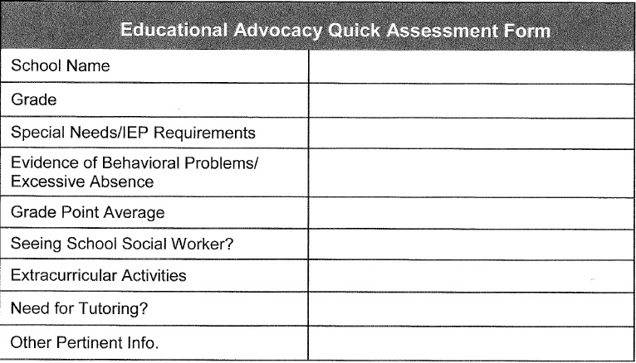
Pre-Service Training: Day 2 :
Activity Time: Educational Needs Assessment
Notes:
Activity 4.17 Educational Needs Assessment
Have participants reference their court report notes that were taken earlier and discuss as a class each of these categories for Maria Amarillo.
Activity 4.17 Educational Needs Assessment
Duration: 10 Minutes
Goal: To give volunteers a chance to apply educational advocacy and assessment tools to a case.
Step 1: Ask participants to discuss the Educational Advocacy Quick Assessment form found on this slide. Consider some of these categories in relation to Maria Amarillo. Did any participants capture these categories in their notes from the previous note taking activity? What information is missing that might be important to know? Why is it important to dig into the educational life of a child?

Slide 98

Pre-Service Training: Day 2 :
Activity Time: Educational Needs Assessment
Questions to consider:
How might a tool like Educational Needs Assessment be helpful in a case with an older youth?
How might it be helpful in a case with a younger or even preschool-aged child?
How might it be helpful in preventing problems and intervening early so that students can be successful?
Notes:
Activity 4.17 Educational Needs Assessment
Duration: 10 Minutes
Step 2: How might a tool like Educational Needs Assessment be helpful in a case with an older youth?
How might it be helpful in a case with a younger or even preschool-aged child?
How might it be helpful in preventing problems and intervening early so that students can be successful?

Slide 99

Pre-Service Training: Day 2 :
Advocating for Older Youth
Older Youth in foster care may have different needs, such as:
Education
Living Situation
Mental Health
Employment
Finances
Notes:
Advocating for older youth can look a little bit different as they approach adult hood. Your basic function will remain the same as a CASA but there are more things to consider with regards to their transition into society. Some of those consideration might be:
• Education
• Housing or Living Situation
• Mental Health
• Employment
• Finances

Slide 100

Pre-Service Training: Day 2
Citizen Review Board (CRB)
3B
3F
8D
Citizen Review Board members are volunteers who are appointed to serve on a review board in the county where they live or work. They are responsible for reviewing the cases of children and/or youth who are in foster care. Cases of dependent children in the custody of the Department of Human Services are reviewed every six months to ensure that the case plan provides for appropriate services and treatment to address the child’s safety, health and well-being, and provides permanency in the shortest time possible.

Slide 101
Pre-Service Training: Day 2
Citizen Review Board (CRB)
3B
3F
8D
THE CRB VISION
Citizens will shape public policy and actively promote conditions which ensure:
• every child lives in a safe, secure, healthy and permanent home, preserving families whenever possible, and
• youth offenders become successful and productive members of society.
THE CRB MISSION
The mission of the Oregon Judicial Department’s Citizen Review Board is to:
• conduct case reviews of children and youth in substitute care to ensure that appropriate services and plans are in place;
• deliver findings and recommendations to the juvenile court, agencies and parties; and
• advocate for change in policies, procedures and laws to improve the child welfare and juvenile justice systems.

Slide 102
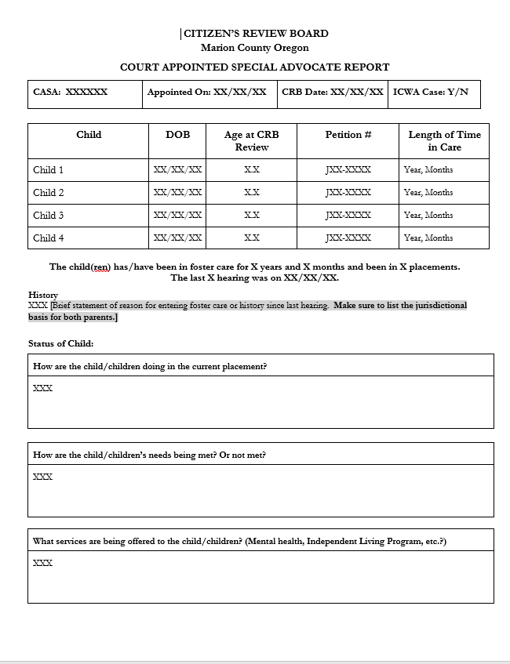
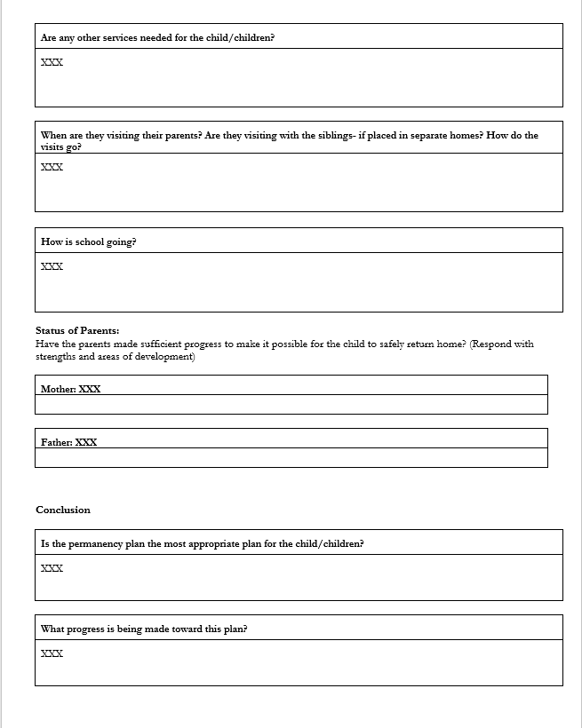
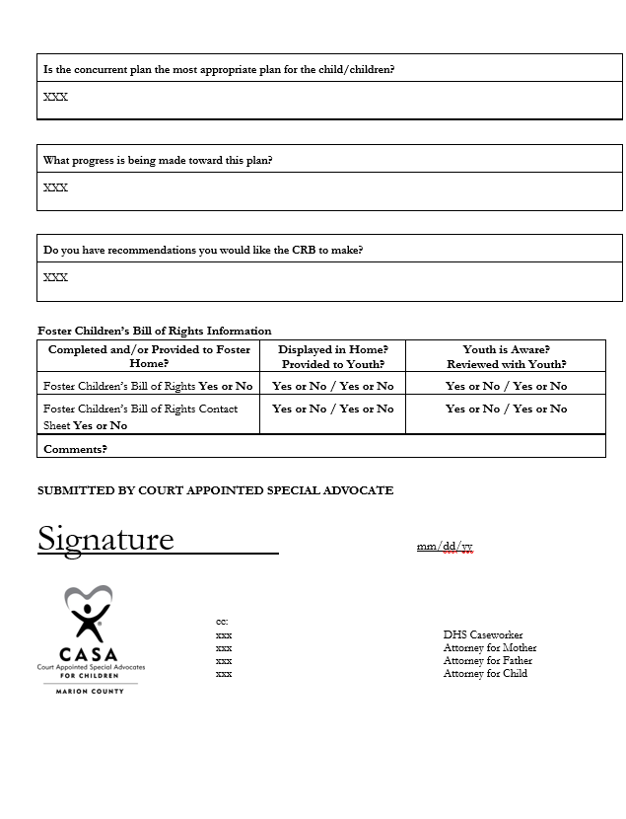
Pre-Service Training: Day 2
Citizen Review Board (CRB)
3B
3F
8D
Notes:
Quickly walk through all the sections of the CRB Report. (One page will appear with every click forward.)

Slide 103


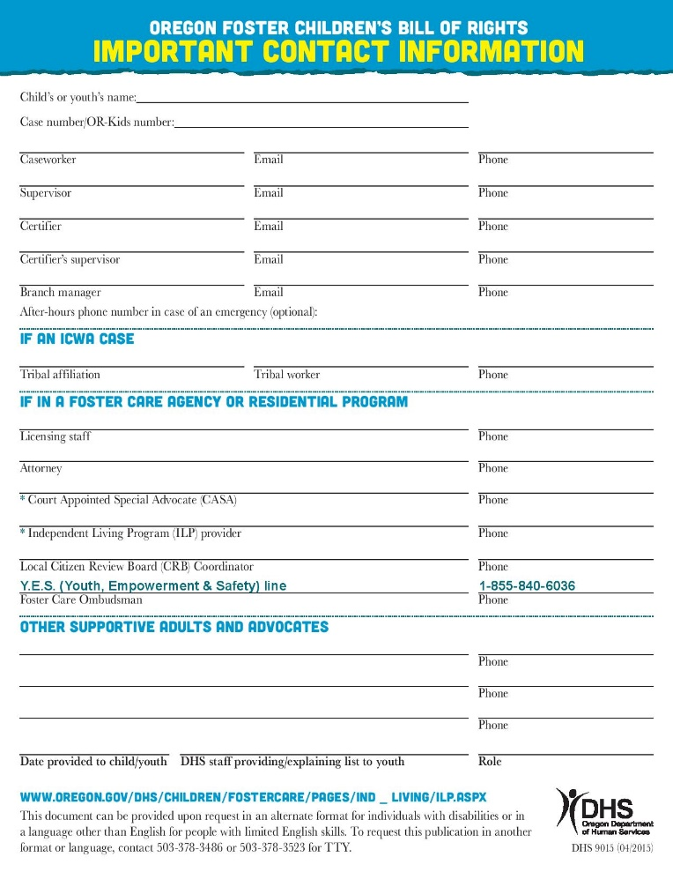
Pre-Service Training: Day 1
Oregon Foster Children’s Bill of Rights
Every child in foster care is endowed with the rights inherently belonging to all children. In addition, because of the temporary or permanent separation from, and loss of, parents and other family members, the child requires special safeguards, resources, and care.

Slide 104
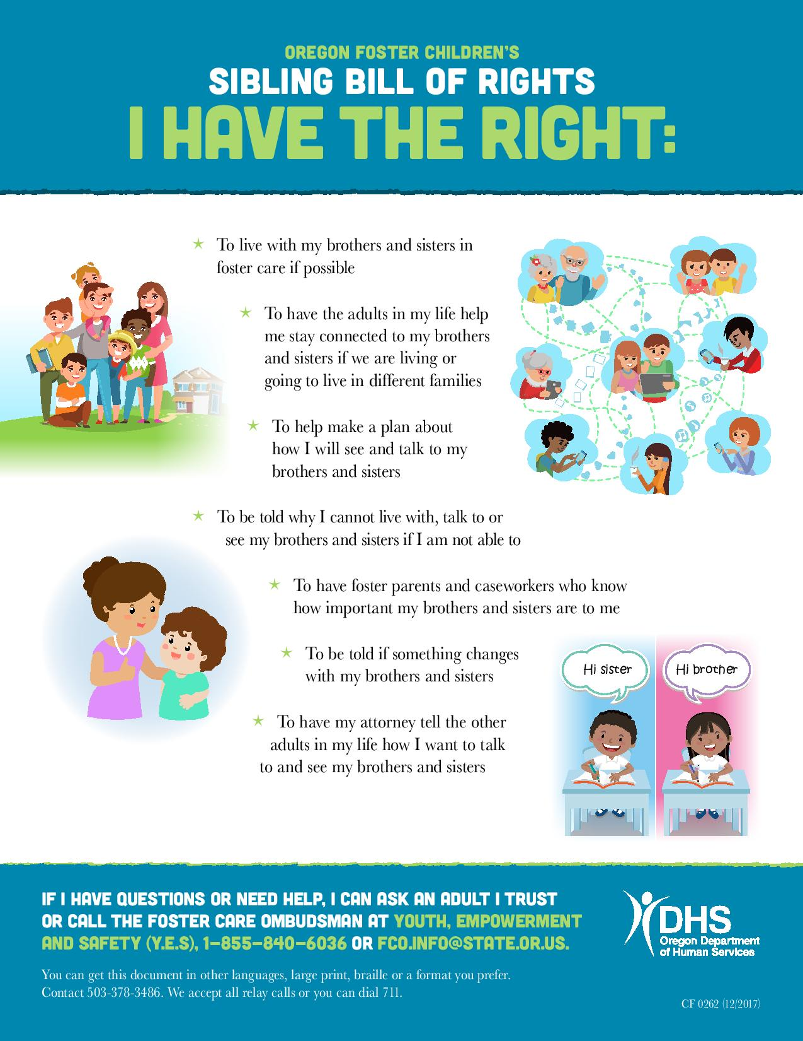
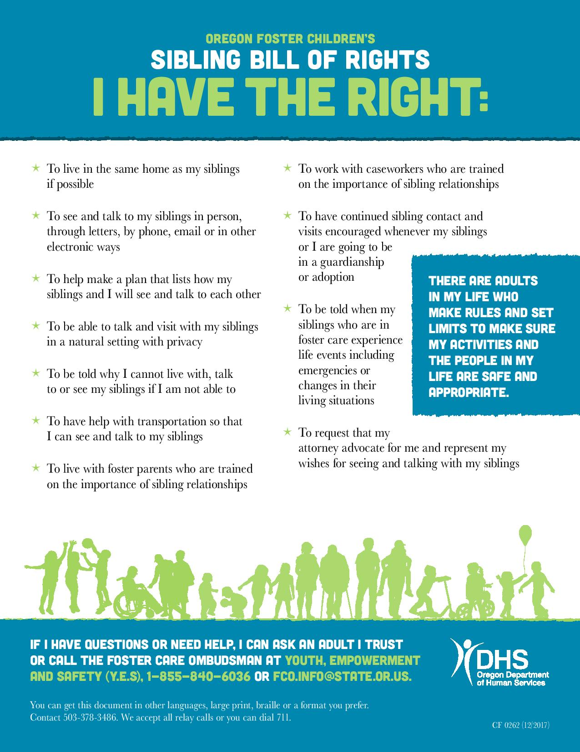
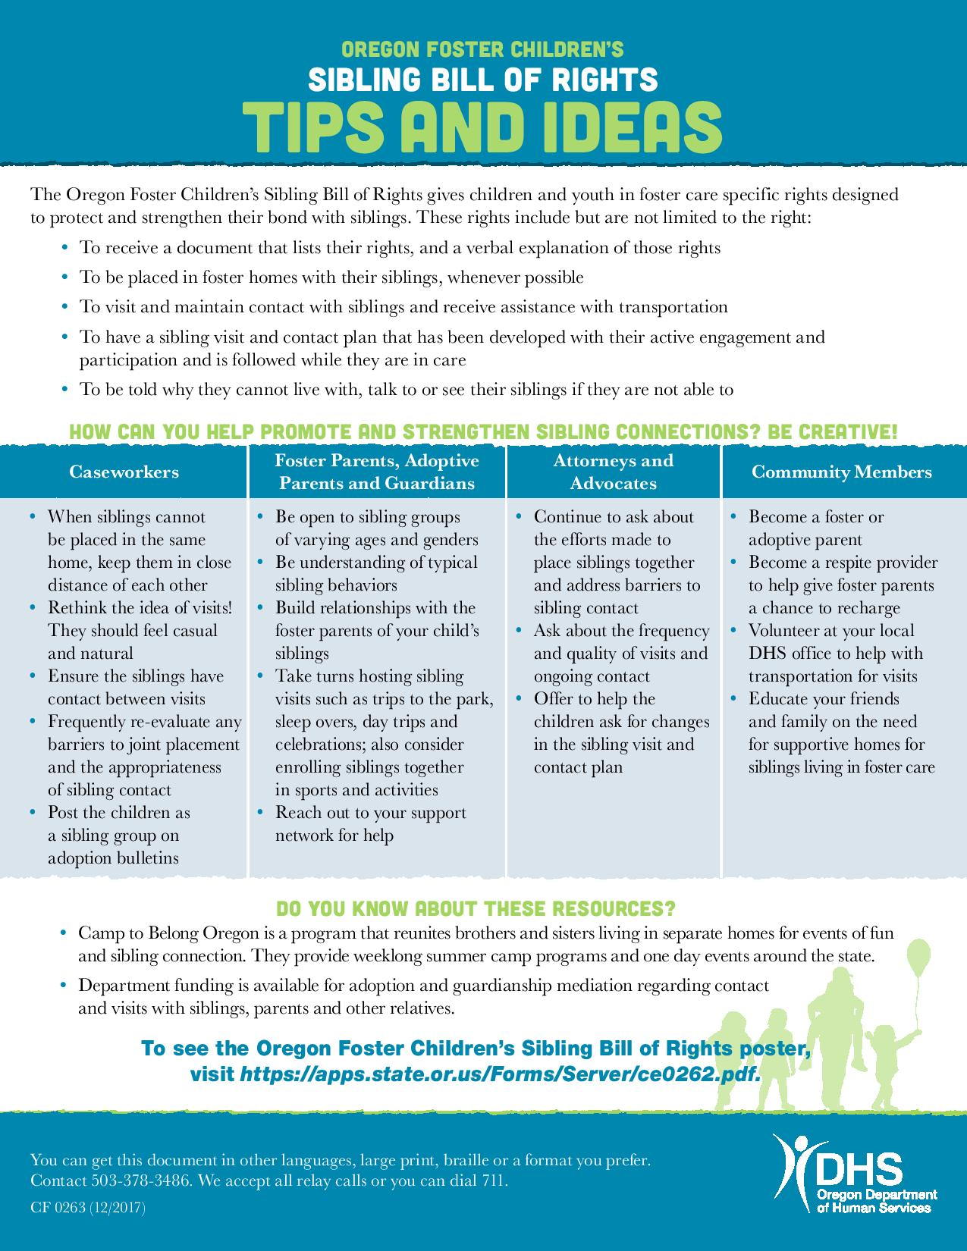
Pre-Service Training: Day 1
Oregon Foster Children’s Sibling Bill of Rights

Slide 105
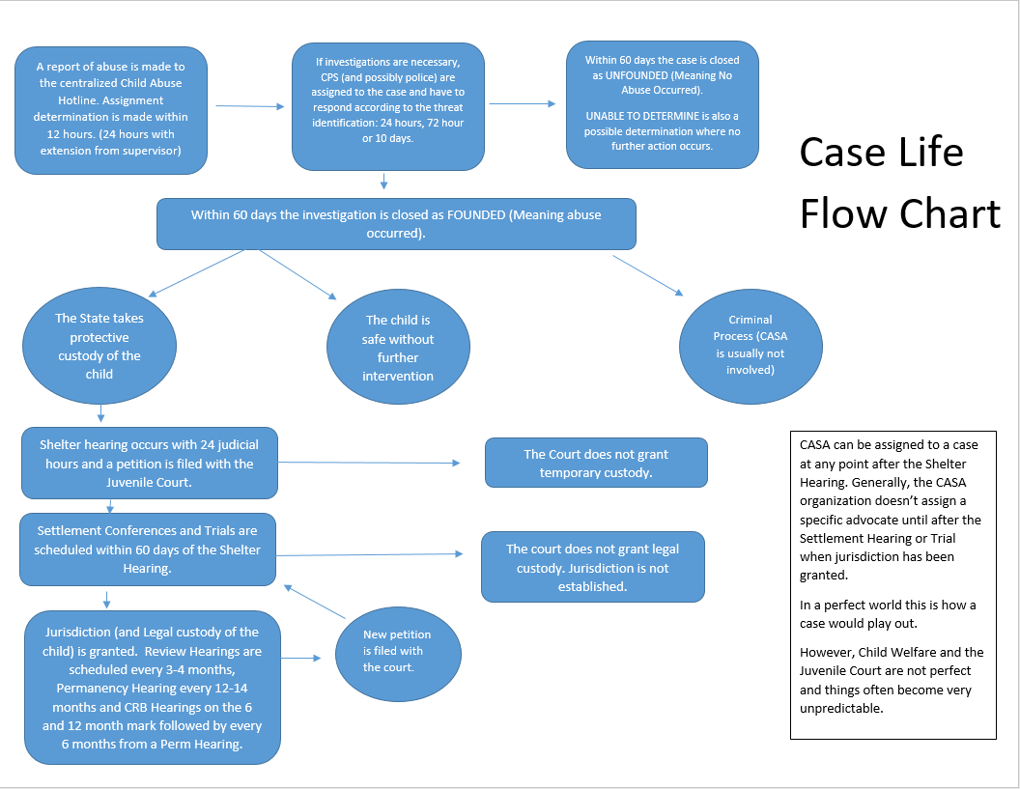
Notes:
Optional: This may be too much information for trainees.

Slide 106
Pre-Service Training: Day 2
Mandatory Reporting
As a CASA you will be required to make mandatory reports just as many other professions are. This includes firefighters, day care workers, police officers, caseworkers, doctors, nurses, teachers etc.
It is not your job to figure out if abuse occurred. CPS investigators are charged with that task.
If you have any uncertainty on whether or not a report needs to be made then make it!
You never know what other information may have already been reported. Maybe your report is the missing piece or could provide more clarity for investigators.
If you have more questions about mandatory reporting feel free to reach out to your coordinator once they are assigned!

Slide 107
Pre-Service Training: Day 2:
Mandatory Reporting

Slide 108

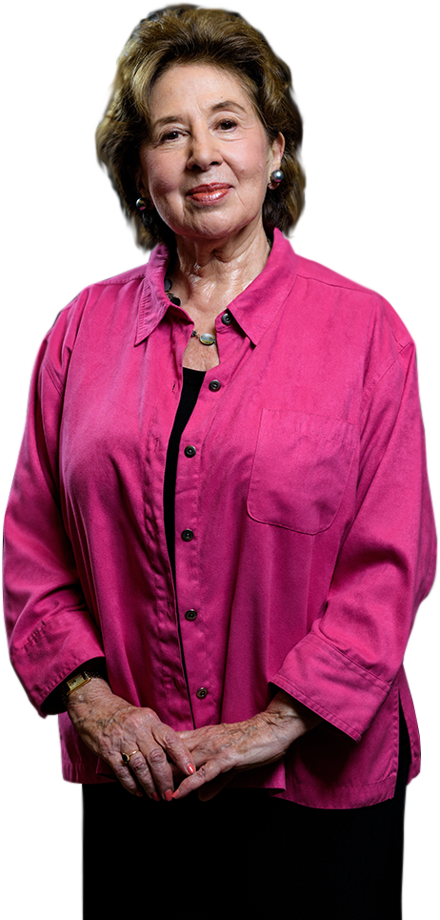
Pre-Service Training: Day 2
CASA Details
8F
What to expect from your Advocate Coordinator.
When and how you’ll be sworn in as CASA volunteers.
CASA Email- GSuite
  Use only this email for CASA business, please.
12 Hours of Continuing Education.
  (6 hours for you as June is your first active month)
SOS and Lunch ‘n Learn and RSVP for EVERYTHING.
Keep an eye out for Monthly Newsletters!
Hours and Miles must be turned in each month.
Court Reports must be turned in for staff review 10 buisness days before your court hearing.
Must see your kids 1x/30 days, no “expensive” gifts and no transporting.
Post Interview, Case Assignment, Case Closure and tell our office of court hearings.
Monthly case meetings.
Transport?

Slide 109

Pre-Service Training: Day 2
CASA Volunteer Assessment

Slide 110
Pre-Service Training: Day 2
Wrap Up
Stay tuned for post training interviews (CASA badge photos will be taken when you come in for the interview)
Swearing-In Ceremony (Please have 100% of the online training done by swearing in)
Coordinator Assignment
Case Pitch

Slide 111

Pre-Service Training: Day 2 :
Wrap-up
Notes:
Goal: To allow your program to gather one last set of feedback data from participants.
Allow time for participants to complete the Session 5 Evaluation.

